Slide 1
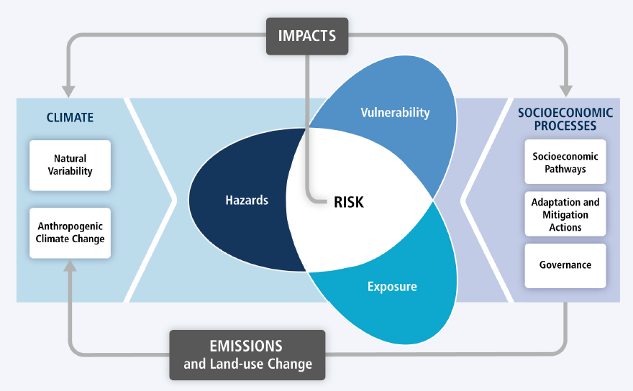
IPCC 2014

Slide 2
Key challenges facing communities, and approaches to solutions that enhance resilience: through NAPs
Climate and Health Summit 2014
Investing in community adaptation and resilience
6 December 2014, Lima, Peru
Paul Desanker
Manager, National Adaptation Plans and Policy, UNFCCC Secretariat

Slide 3
Key challenges
Gaps in knowledge on theories of change on adaptation to climate change, which could guide the development of effective processes as well as monitoring and evaluation systems;
Coordinated, comprehensive, medium- and long-term approach towards addressing adaptation at all levels;
Harmonizing adaptation with key development priorities, policies and plans;
Etc.

Slide 4
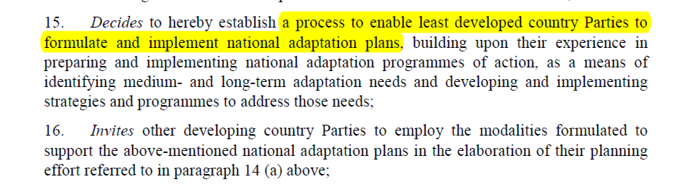
National adaptation plans (NAPs)
Established in 2010, under the Cancún Adaptation Framework (CAF)
…
…
See decision 1/CP.16, paragraphs 15 - 18

Slide 5
Objectives of the NAP process (decision 5/CP.17, paragraph 1)
To reduce vulnerability to the impacts of climate change, by building adaptive capacity and resilience;
To facilitate the integration of climate change adaptation, in a coherent manner, into relevant new and existing policies, programmes and activities, in particular development planning processes and strategies, within all relevant sectors and at different levels, as appropriate.

Slide 6
Guiding principles of the NAP process (decision 5/CP.17)
Continuous planning process at the national level with iterative updates and outputs
Country-owned, country-driven
Not prescriptive, but flexible and based on country needs
Building on and not duplicating existing adaptation efforts
Participatory and transparent
Enhancing coherence of adaptation and development planning
Supported by comprehensive monitoring and review
Considering vulnerable groups, communities and ecosystems
Guided by best available science
Taking into consideration traditional and indigenous knowledge
Gender-sensitive

Slide 7
D. Reporting, Monitoring
and Review
1. Monitoring the NAP process
2. Reviewing the NAP process to assess progress,
effectiveness and gaps
3. Iteratively updating the national adaptation plans
4. Outreach on the NAP process and reporting on
progress and effectiveness
A. Laying the groundwork
and addressing gaps
1. Initiating and launching of the NAP process
2. Stocktaking: identifying available information on
climate change impacts, vulnerability and
adaptation and assessing gaps and needs of the
enabling environment for the NAP process
3. Addressing capacity gaps and weaknesses in
undertaking the NAP process
4. Comprehensively and iteratively assessing
development needs and climate vulnerabilities
C. Implementation Strategy
1. Prioritizing climate change adaptation in national
planning
2. Developing a (long-term) national adaptation
implementation strategy
3. Enhancing capacity for planning and implementing
adaptation
4. Promoting coordination and synergy at the regional
level and with other multilateral environmental
agreements
B. Preparatory Elements
1. Analysing current climate and future climate
change scenarios
2. Assessing climate vulnerabilities and identifying
adaptation options at the sector, subnational,
national and other appropriate levels
3. Reviewing and appraising adaptation options
4. Compiling and communicating national
adaptation plans
5. Integrating climate change adaptation into
national and subnational development and
sectoral planning
NAP process (elements and sample steps)
See page 23 of the technical guidelines for the NAP process

Slide 8
identify opportunities for integration build resilience and reduce vulnerability
1. Characterizing the development context
2. Characterizing climate risks and sources of key vulnerabilities
3. Integrated assessment of climate change risks and vulnerabilities
4. Scenarios and pathways of development in a changing climate
5. Prioritizing actions to build resilience, reduce vulnerability & address climate risks
6. Design of coherent implementation strategies
7. Implementation & management of action
Monitoring
Assessment
Revision
Stocktaking, identifying and addressing gaps and needs, building readiness and capacity, awareness raising, learning
Process to formulate
and implement NAPs
-----------------------------
under the UNFCCC
Governance structures, coordinating mechanisms, accessing and managing support

Slide 9
Support to the NAP process
Technical support
  Convention: Least Developed Countries Expert Group (LEG), Adaptation Committee
  UN organizations and specialized agencies, multilateral and bilateral agencies, regional centres and networks
  NAP GSP
Financial support
  Convention: LDCF, SCCF, AF, GCF.
  UN organizations and specialized agencies, multilateral and bilateral agencies, regional centres and networks

Slide 10
Starting the NAP process
When has a country started the NAP process?
  Scoped required activities to drive the NAP process (mandates, institutions, relevant stakeholders, resources), building upon ongoing relevant activities
  Compiled and communicated a roadmap or strategy, including milestones, for the initial phase of the national process
  Some countries are organizing “launch events”
A country can communicate the initiation of its NAP process nationally and to the UNFCCC, LEG, AC, etc.

Slide 11
Experiences, good practices, lessons learned, gaps and needs
Many countries have started various activities towards the NAP process
Capacity-building on an ongoing basis on various aspects of the NAP process is needed
Data, methods and tools on climate change and relevant development aspects in support of adaptation planning and implementation are needed
LEG to continue to look deeper into the technical aspects of the NAP process through technical meetings involving various experts
More details on what will NAPs contain, whether they will be submitted to the UNFCCC, how will they be implemented, monitored, etc.
Detailed information in document FCCC/SBI/2014/INF.14

Slide 12
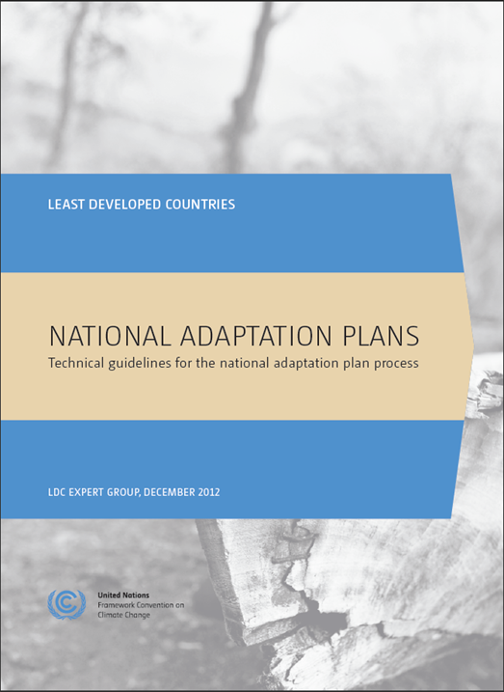
Technical guidelines for the NAP process
Languages: English, French and Portuguese and Spanish
Available in hard copies and online on <http://unfccc.int/7279>.
Are applicable to non-LDC developing countries (AC NAP TF)
The guidelines provide the basis for the formulation and implementation of NAPs

Slide 13
The NAP Central
NAP guidelines
Resources by hazards, sectors, or adaptation elements
Country portals
Navigators for tools, data, case studies, etc.
Support: GSPs, funding, training, tracking
Databases
Marketplace: for projects/activities (NAP exchange)
Support Group
LEG and AC members
NAP GSP
Partner organizations
Timeline:
2013-2015: Continuous development
December 2013: Launch of 1st prototype
June 2014: Support Group meeting
October 2014: Full prototype

Slide 14
Key decisions
1/CP.16: establishment of the process
5/CP.17: framing; objectives; guidelines; financial and technical support; reporting, monitoring and review
12/CP.18: financial support for the LDCs through the LDCF; consideration for non-LDCs through the SCCF
18/CP.19: further invitations on financial and technical support
-/CP.20: communicating process, outputs and outcomes; submission of NAPs to NAP Central

Slide 15
Highlights from decision -/CP.20
No need to revise the initial guidelines for formulation of NAPs at this time
NAPs can serve as an important tool for ensuring common understanding and communicating progress towards reducing vulnerability and integrating adaptation into development planning;
Importance of communicating outputs and outcomes of the process to formulate and implement NAPs
Countries to submit their NAPs and outcomes to the NAP Central
Adaptation Committee, Least Developed Countries Expert Group, Green Climate Fund to consider how to best support developing countries to access funding from the Green Climate Fund

