Slide 1

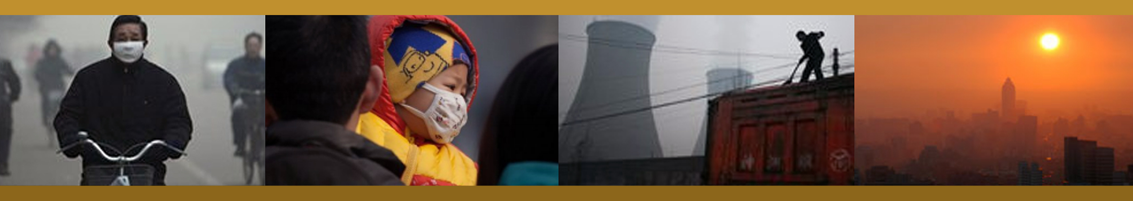
From Health Impacts to
Health Sector Impact
COAL
Josh Karliner
Health Care Without Harm
Climate and Health Summit 2014
Lima, Peru

Slide 2
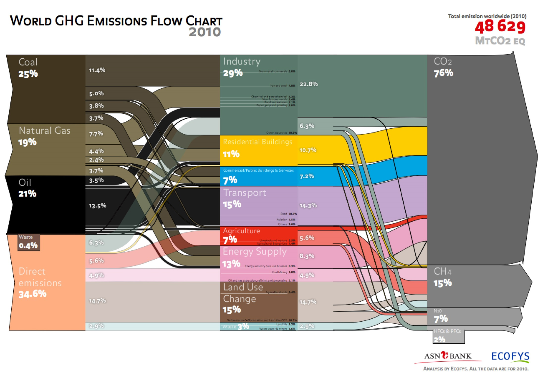
Notes:
Coal accounted for 25% of global GHG emissions as of 2010…
Source: Ecofys 2013 via Tcktcktck http://tcktcktck.org/2013/05/infographic-global-greenhouse-gas-emissions-mapped-from-source/52537

Slide 3
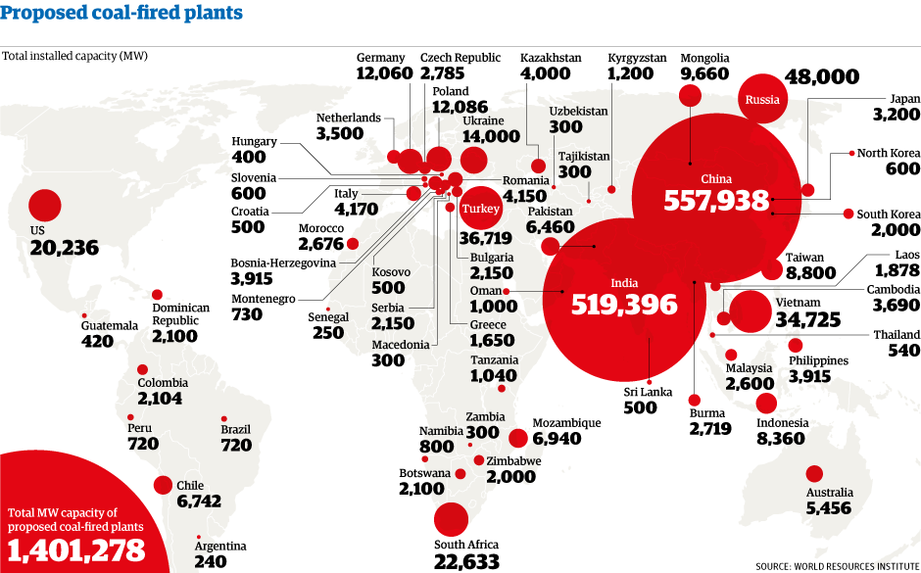
Notes:
… 25% might not seem like much, but consider the rapid expansion of coal projected in places like China and India
Source: WRI 2012 via the Guardian http://www.theguardian.com/environment/picture/2012/nov/20/which-countries-most-coal-power

Slide 4
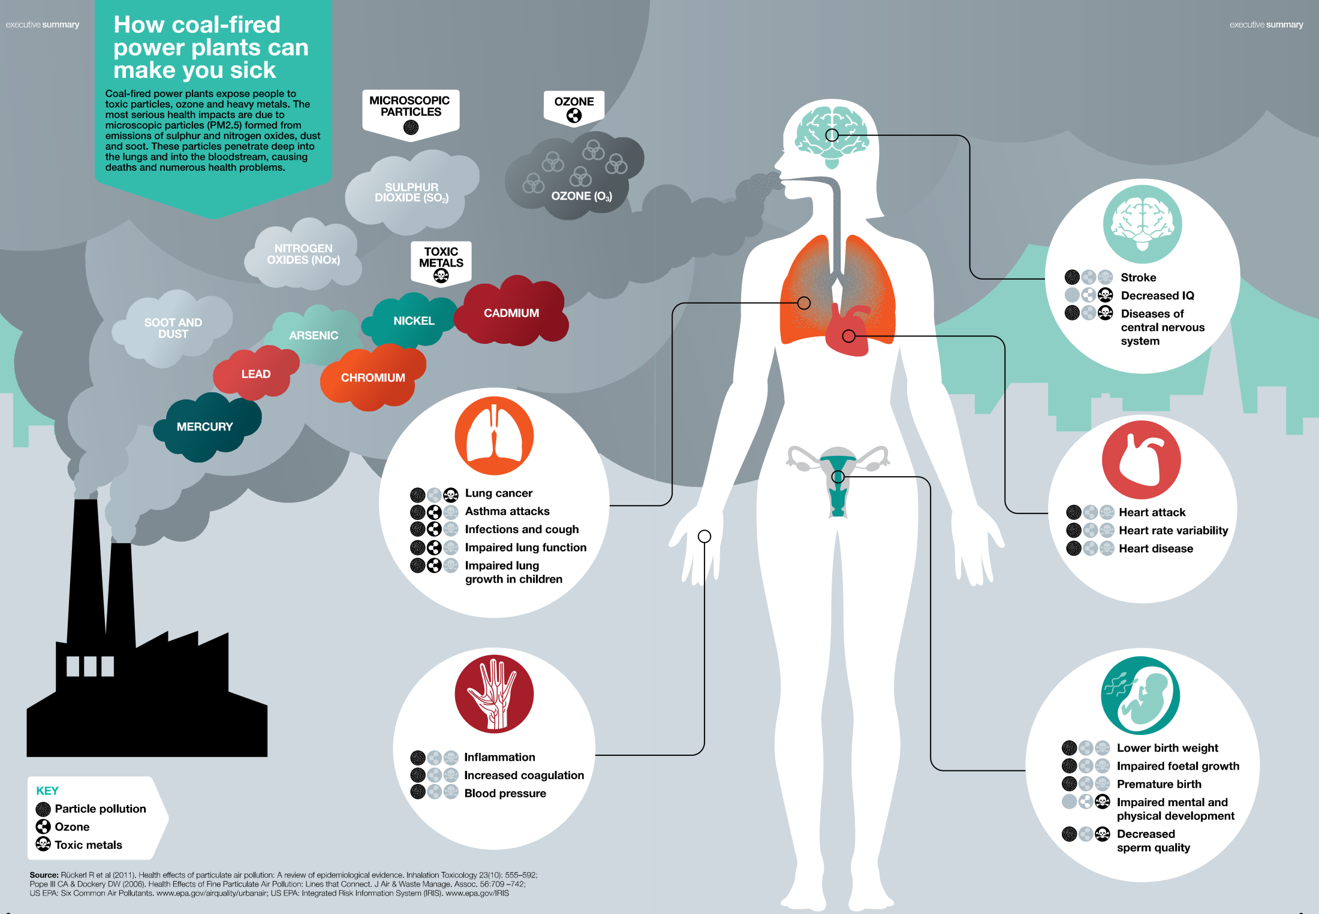
Notes:
… 25% might not seem like much, but consider not only the global climate change impacts, but also the local health consequences of coal combustion.
Image courtesy Greenpeace

Slide 5
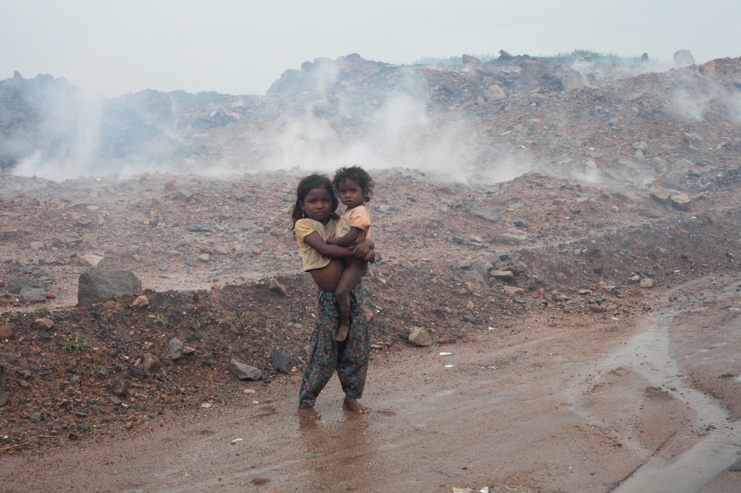
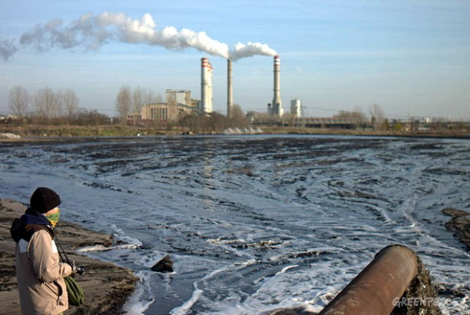
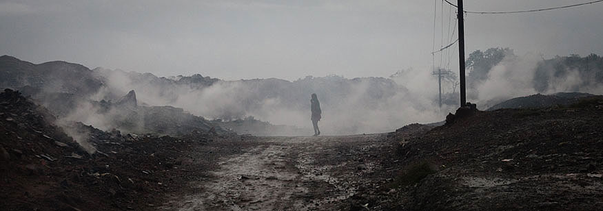
Notes:
In addition to combustion, there are also serious environmental and health impacts from mining, transport, storage, and waste disposal
Clockwise from top left:
Image of coal miner (location unknown) from http://itech.dickinson.edu/chemistry/?p=318
Image of coal rail transport (in India?) from Jagran Post Editorial http://post.jagran.com/3-fasttrack-rail-projects-to-transport-300-million-tonne-coal-1380434146
Image of contaminated waste water in lake from coal fired power plant in Poland, courtesy of Greenpeace http://www.greenpeace.org/eastasia/multimedia/photos/climate-energy/cimate-change-Konin-plant/
Image of coal yard in India courtesy Amritraj Stephen/Community Environmental Monitoring (coal yard)

Slide 6
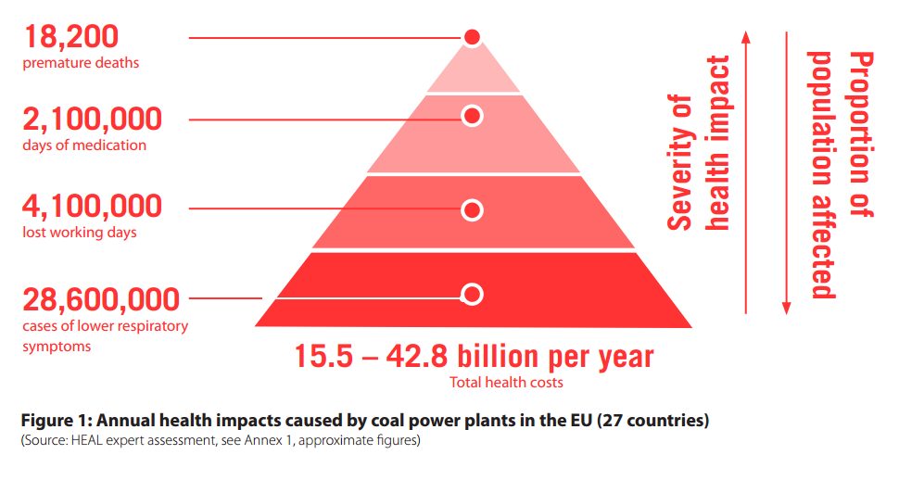
Europe
Notes:
Source: HEAL, The Unpaid Health Bill 2013

Slide 7



The Health Sector Helps Drive Transformational Change

Slide 8


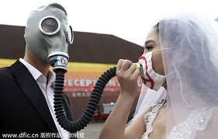


Public Health = Healthy Energy
Notes:
"Evidence on the full range of health effects of air pollution was used in a lawsuit that led to the overturn of an environmental permit granted to a coal fired power plant. The plant was to be located in a coal mining region that already had some of the worst air quality in Poland.”
Image credits clockwise from top left:
ALA
Unknown (I can look up later)
Tianamen Sq picture from Greenpeace
China graphic from Lifeng Fang slides
http://www.chinadaily.com.cn/china/2014-03/01/content_17314677.htm
CAPTION FROM JOANNA/VIKAS:
Health has been the most important argument in the fight against coal in the US, with lobbying and media efforts’ directly focused on EPA’s Clean Air Act. Health groups and arguments central to Mercury and Air Toxics Standard and EPA’s proposed Clean Power Plan
Greenpeace and IPE have employed two pronged health arguments in campaign against air pollution: policy on national level and local impacts
The government has issued anti-smog plan and some curbs on coal use
China has shown that even in politically sensitive environments, health argument delivered via scientific research and citizens’ social media campaigns, can be successful in cutting coal use.
In Australia, Turkey, South Africa and the Philippines, health is increasingly being seen as an important tool in the campaign kit.

Slide 9

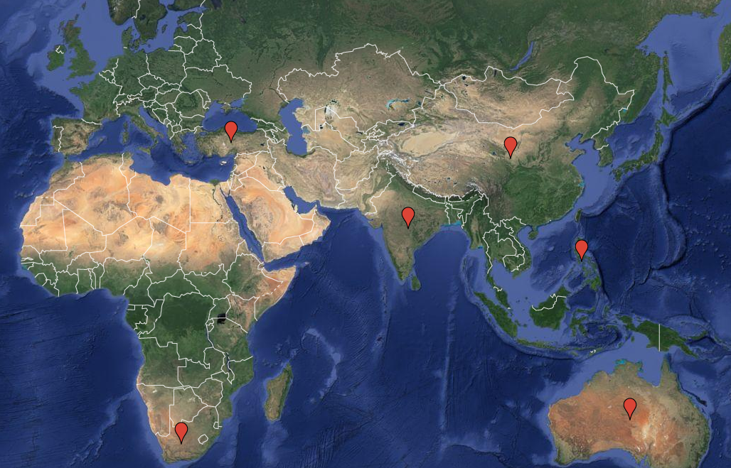























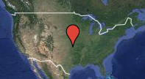
Healthy Energy Initiative
Turkey
China
India
Philippines
South Africa
Australia
USA
Notes:
Research institutions/projects:
Columbia University Mailman School of Public Health: Coal combustion health impacts and prevention using molecular epidemiology (US, Poland, China)
Health Effects Institute: Global Burden of Disease: Major Air Pollutant Sources (China, India, Central/Eastern Europe)
Harvard University and Greenpeace: Southeast Asia Coal-Health Project (11 countries in equatorial Asia)
University of Illinois at Chicago: Coal and health literature review
National partners:
CHINA: Rock Environment and Energy Institute
INDIA: The Other Media
SOUTH AFRICA: groundWork
EUROPE: Health and Environment Alliance
AUSTRALIA: Climate and Health Alliance
PHILIPPINES: Health Care Without Harm – Asia
National health research relationships:
CHINA: Peking University, Fudan University
EUROPE: School of Hygiene and Tropical Medicine
INDIA: Post Graduate Institute of Medical Education and Research, Chandigarh; Jawaharlal Nehru Institute of Postgraduate Medical Education and Research; Manipal Univ. School of Public Health; SRM Univ. School of Public Health; All India Institute of Hygiene and Public Health
AUSTRALIA: Universities of Sydney, Melbourne, and Newcastle
SOUTH AFRICA: University of Cape Town, University of Stellenbosch

Slide 10
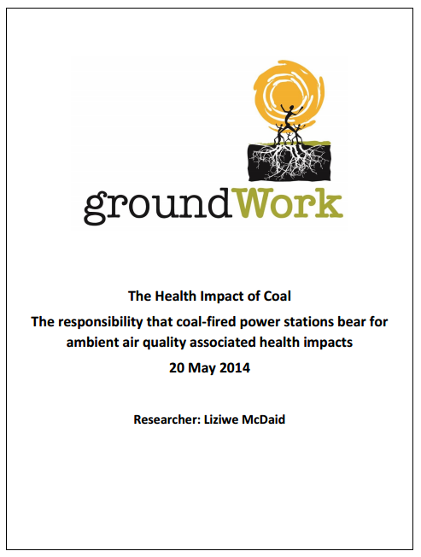


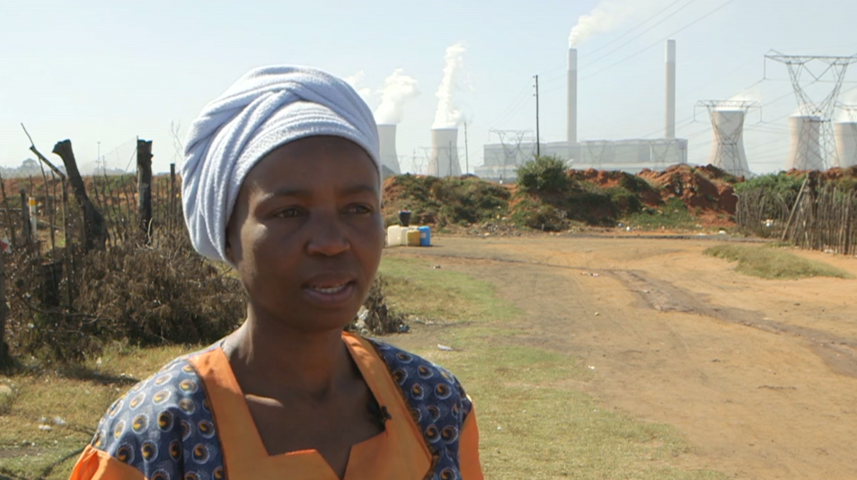
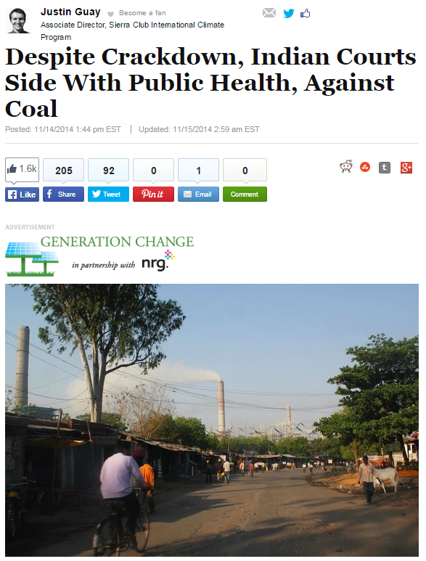
Action Around the World
Notes:
WFPHA meeting as key moment
Sources:
http://www.huffingtonpost.com/justin-guay/despite-crackdown-indian_b_6159956.html
http://www.scientificamerican.com/article/black-wind-from-coal-keeps-pregnant-women-away/

Slide 11
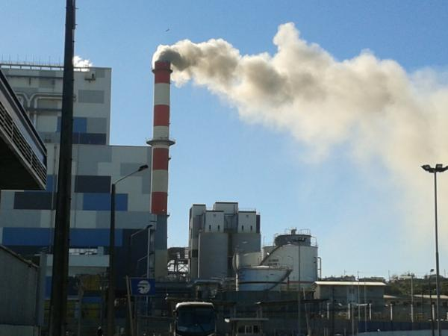
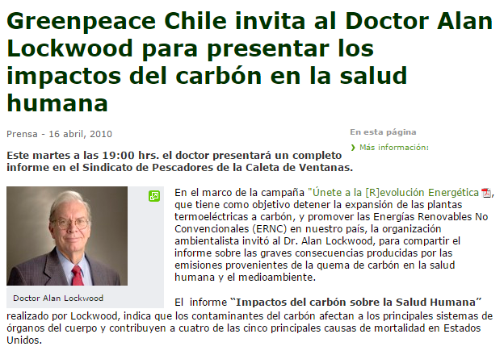
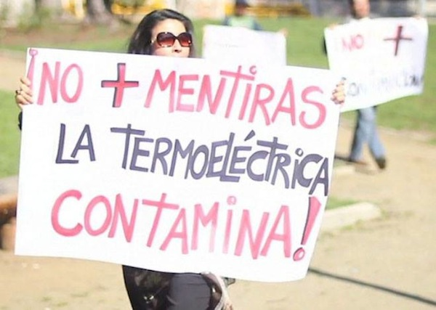
Chile
Notes:
ARTICLE SOURCE: http://www.greenpeace.org/chile/es/prensa/comunicados-de-prensa/greenpeace-chile-invita-a-dr-a/
TOP PHOTO: via http://santiagotimes.cl/local-courts-freeze-coal-fired-power-plant-concepcion/
The Bocamina II power plant has caused social opposition for its damaging effect on the surrounding sea life and air pollution. Photo by RNE_325_Miguel / Twitter
BOTTOM PHOTO: via http://santiagotimes.cl/construction-concon-thermoelectric-power-plant-stalled-courts/
Photo via NO A LA TERMOELÉCTRICA DE CONCON / Facebook

Slide 12




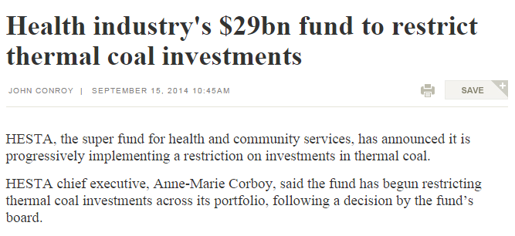
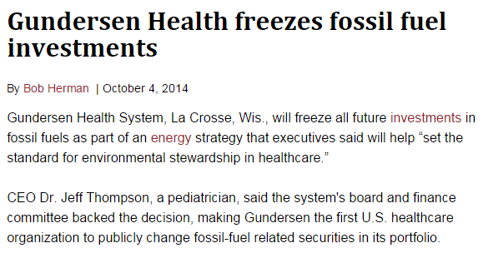
Divestment from Coal is Gaining Traction
Notes:
3 health organizations on 3 continents made fossil fuel divestment (or restriction of investment) commitments in 2014:
BMA (June)
HESTA (Sep)
Gundersen Health System (Sep/Oct)
Images courtesy Healthy Planet UK

Slide 13
Healthy Energy Initiative:
A Vision for Health Sector Impact
Health Impact Assessments are integrated into national and local energy decision-making
Health costs of coal are internalized and become financial barrier to expansion
Health professionals collaborate with communities to address the local health impacts of coal and to advocate for healthy energy
Global consensus builds in the health sector against coal and for clean and healthy energy
Health sector divests from coal
Health messaging galvanizes public support in multiple countries to move away from coal and towards clean energy
National campaigns + global collaboration + communication = success

Slide 14
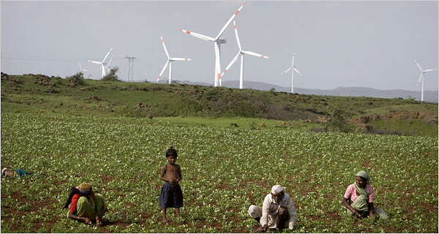
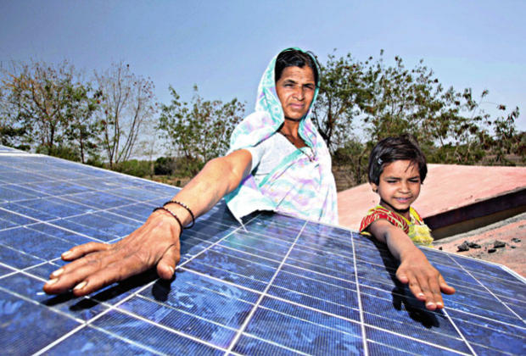
A just transition
to a clean energy future
is a public health imperative.
Notes:
Images unattributed, found on http://econews.com.au/news-to-sustain-our-world/india-wants-renewables-without-subsidy-more-solar/

