Slide 1
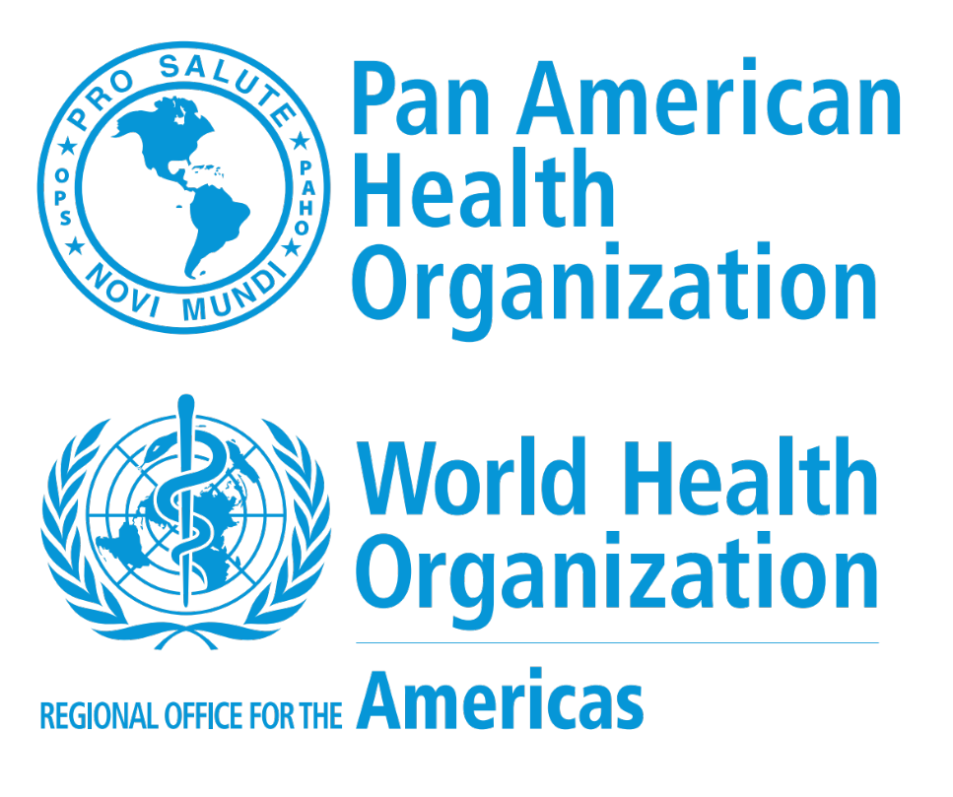

Slide 2

Climate Change and Health: Focus in Latin America and the Caribbean
Dr. Agnes Soares, Regional Advisor, SDE, PAHO/WHO
CLIMATE AND HEALTH SUMMIT
ALONG SIDE THE 20TH CONFERENCE OF THE PARTIES
LIMA, PERU, 6TH DECEMBER 2014

Slide 3

Regional Plan of Action on Climate Change
PAHO/WHO

Slide 4
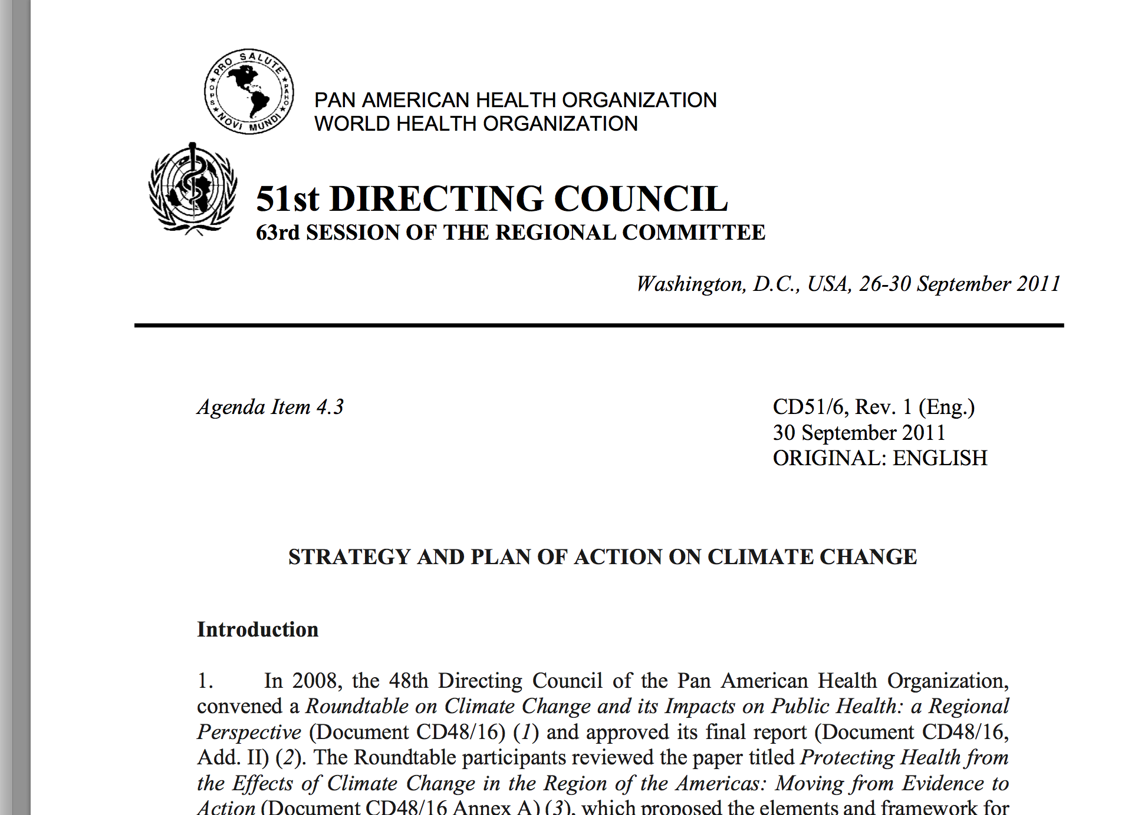
Goals
Public health security at the center of the response to climate change.
Implementation of key actions at local, national, and regional levels to minimize the impacts of climate change on health and to encourage the health sector to adopt energy management measures to mitigate climate change and avoid additional, potentially disastrous impacts on health.
Notes:
To prepare and strengthen national and local health systems to protect human health from risks related to climate change. Public health security at the center of the response to climate change.
Implementation of key actions at local, national, and regional levels to minimize the impacts of climate change on health and to encourage the health sector to adopt energy management measures to mitigate climate change and avoid additional, potentially disastrous impacts on health.

Slide 5
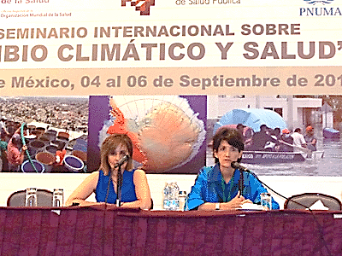
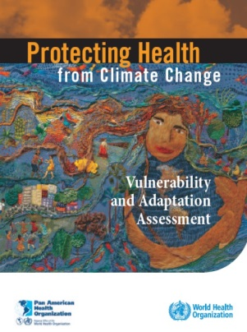
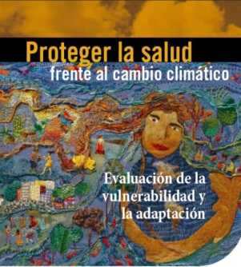

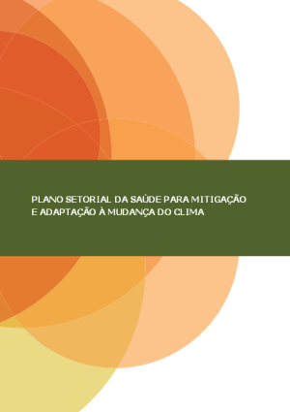
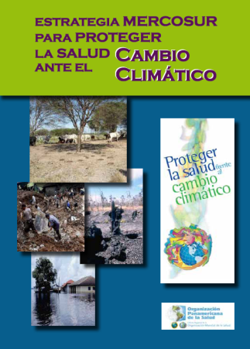
Awareness and
education
Evidence
Being SMART
safer, ecofriendly and disaster resilient hospitals
Adaptation
Adaptation,mitigation
and preparedness
Partnerships
Notes:
Strategic areas
evidence, awareness and education, partnerships, and adaptation
Objectives
Knowledge generation for evidence-based actions
Raise awareness and increase knowledge of the health effects of climate change
Promote intersectoral work for policies and interventions that include the health sector
Assess vulnerabilities and identify adaptation interventions
Direct and indirect impact of weather-related disasters can significantly disrupt access to health services and the sector’s ability to provide care. However, today it also is becoming increasingly clear that the health sector itself is one of many contributors to the impact of climate change, making it imperative to step up efforts to reduce the environmental footprint and increase the resiliency of its health facilities.
The Pan American Health Organization (PAHO) is spearheading the Smart Hospitals Initiative in an effort to ensure that health facilities in the Caribbean are both Safe and Green. Smart Hospitals proactively seeks to minimize the health impact of a disaster through climate adaptation,mitigation and preparedness.
Two pilot projects were successfully completed in St. Vincent and the Grenadines and St. Kits and Nevis. The second phase is set to be implemented in many other Caribbean countries

Slide 6

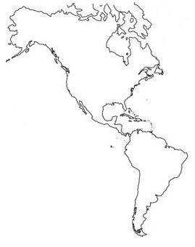
Partnerships
Project ATN/OC-11909-RG-BID
“Instrumentos Regionales para la
Adaptación al Cambio Climático
en el Sector Salud”
FIOCRUZ (BRA) e INSP (MEX)
MERCOSUL
XXVII RMS, Montevideo
Mexico
Proyecto ATCO/BID
“Environmental Health Surveillance System in the Amazon Region”
Colombia
Brasil
Bolivia
Paraguay
Amazon Treaty Cooperation
Organization (ATCO)

Slide 7
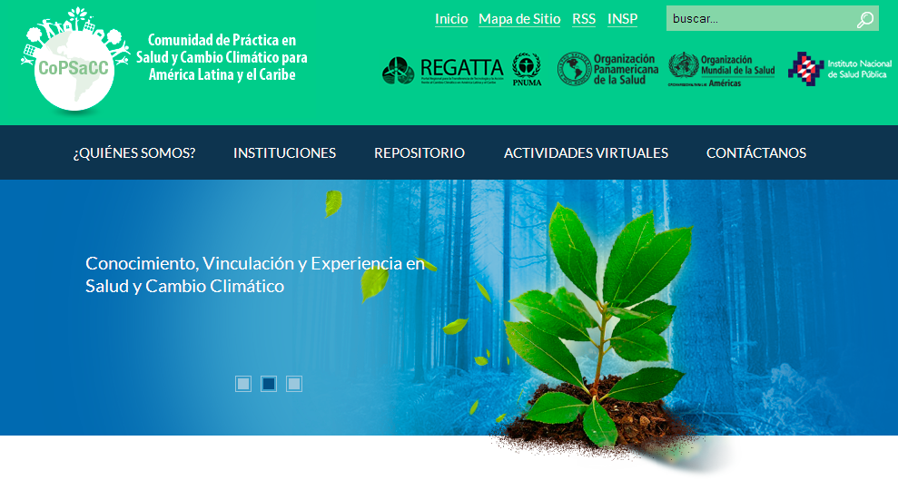
Community of Practice on Health and Climate Change
Comunidad de Práctica en Salud y Cambio Climático
http://www.climasaludlac.org/ OPS-PNUMA-INSP (MEX)

Slide 8
Climate Change, Air Pollution and Health in the Americas

Slide 9
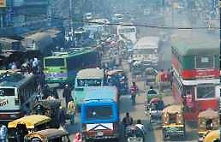
Ambient Air Pollution and Health
~ 22 % of disease & deaths from ischaemic heart disease
~ 15 % of deaths from pneumonia in children under 5
~ 5% of COPD deaths – (from ambient ozone pollution)
152,000 deaths in the Americas in 2012 (WHO, 2014)
Other effects include: Cancer,
asthma, and adverse pregnancy outcomes.
For each 10 µg/m3 increase of PM10 there is an estimated excess or risk of death of 0.7% in Mexico City, Santiago and São Paulo (HEI, 2012. ESCALA)
Notes:
Air pollution is a major preventable cause of disease and death in the 21st century
Reducing BC emissions at the levels proposed by the WHO Air Quality Guidelines protects health, increasing cost-benefits of the interventions

Slide 10
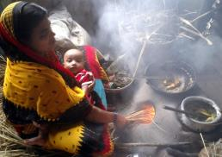
Indoor Air Pollution and Health
~ 50% of all pneumonia deaths among children under 5
~ 30% of all COPD (Chronic obstructive pulmonary disease) deaths
~ 18% of disease & deaths from ischaemic heart disease
80,000 deaths in LAC for the year 2012 (WHO, 2014)
Burning of solid fuels indoors is the main environmental risk in the Americas¹
Other health effects include: Cancer,
Asthma, Cataracts, Adverse pregnancy outcomes, and Tuberculosis
(1) Institute of Health Metrics and Evaluation. GBD 2010 Results by Risk Factor 1990-2010; Results by Risk and Region: [http://www.healthmetricsandevaluation.org/gbd/visualizations/gbd-2010-change-leading-causes-and-risks-between-1990-and-2010

Slide 11
WHO Air Quality Guidelines
 | PM₁₀ (µg/m³) | PM_{2.5} (µg/m³)
Tier 1 | 70 | 35 | Mortality risk 15% > AQG
Tier 2 | 50 | 25 | Mortality risk ~ 6% < Tier 1
Tier 3 | 30 | 15 | Mortality risk ~ 6% < Tier 2
AQG | 20 | 10 | Minimum level with observed effect
WHO Air Quality Guidelines, update 2005
http://www.who.int/phe/health_topics/outdoorair/outdoorair_aqg/en/
The new WHO Air Quality Guidelines provides estimates of emission rates for household combustion fuels linking them to the targets in each tier
WHO guidelines for indoor air quality: household fuel combustion
http://www.who.int/indoorair/publications/household-fuel-combustion/en/

Slide 12
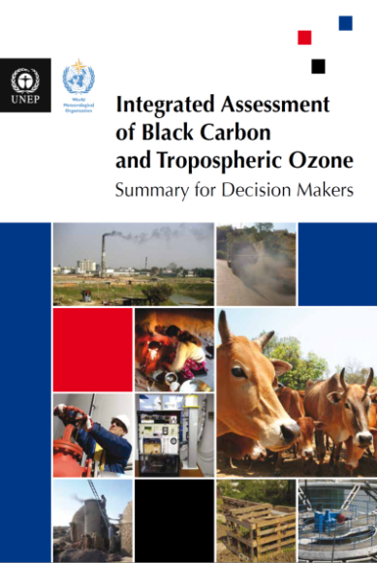
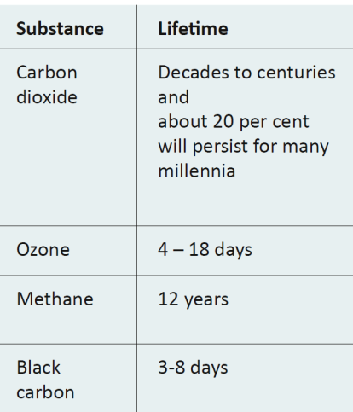
Lifetime of Air Pollutants
Notes:
16 identified measures, implemented by 2030, would reduce warming in LAC by 0.5ºC in 2070 halving the rate of warming projected by the Reference Scenario, and reduce some near term climate change impacts on vulnerable areas, such as the Andes. 8 of these interventions are meant to reduce Black Carbon emissions.
Near-term measures would improve the chance of not exceeding the 2ºC target.
SLCF emission reductions IS NOT an alternative to CO2 mitigation.

Slide 13
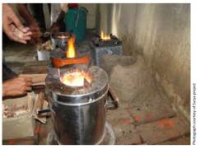
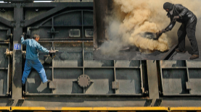
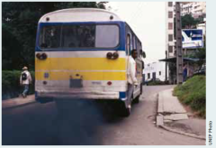
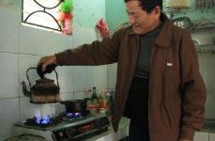
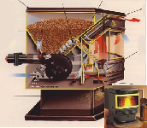
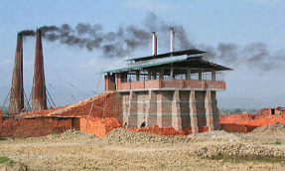
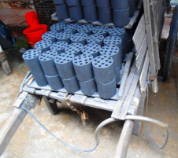

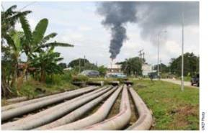
Reducing BC Emissions
Health benefits
Depend on emission rates
Improved biomass stoves
Modern coke ovens
Remove big smokers / DPF
Health benefits
Depend on emission rates
Cooking with clean fuel
Caution: no evidence of benefits for health
Pellet biomass heating stoves
Improved brick kilns
Coal briquettes replacing coal
Reduce agricultural burning
Reduce flaring
Notes:
Best buy policies to reduce black carbon emissions do not necessarily achieve the goal of protecting health.
16 identified measures, implemented by 2030, would reduce warming in LAC by 0.5oC in 2050 halving the rate of warming projected by the Reference Scenario, and reduce some near term climate change impacts on vulnerable areas, such as the Andes. 8 of them refer to reducing Black Carbon emissions.
Near-term measures would improve the chance of not exceeding 2oC target (but only if CO2 is also addressed, starting now; these are complementary strategies, not alternatives).
SLCF emission reductions IS NOT an alternative to CO2 mitigation.

Slide 14
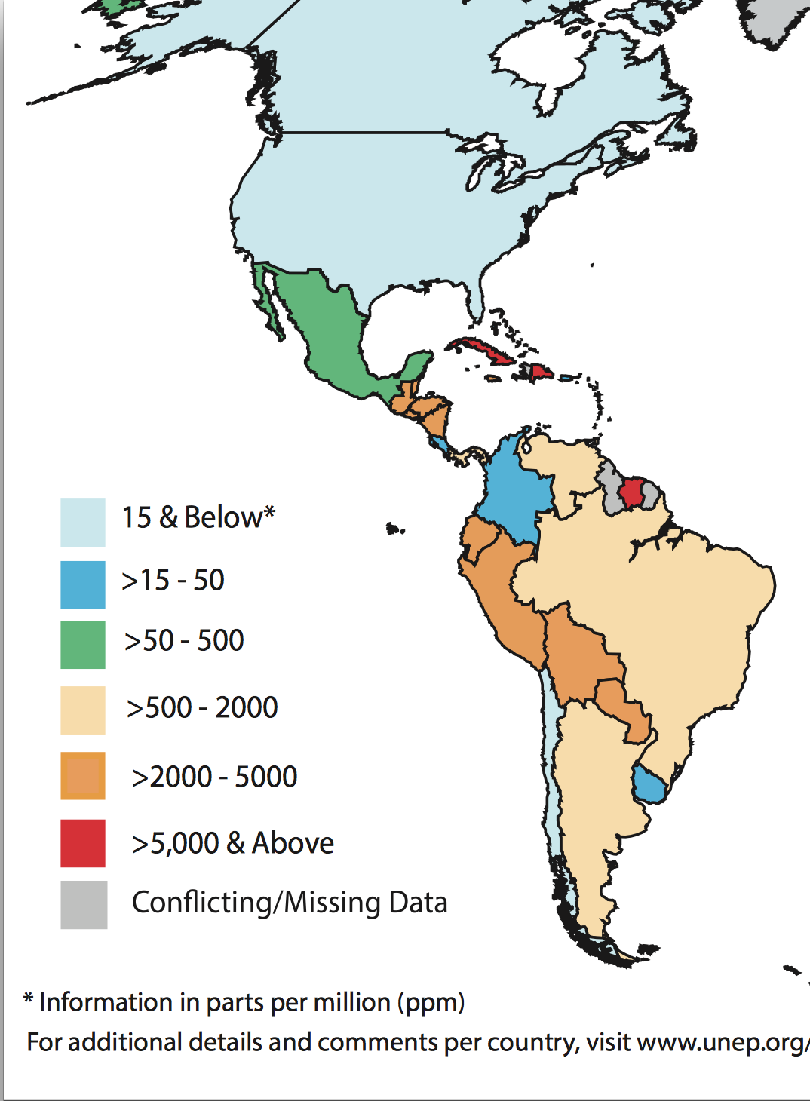
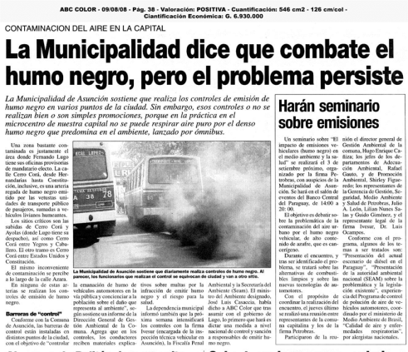
Sulphur content in combustibles

Slide 15
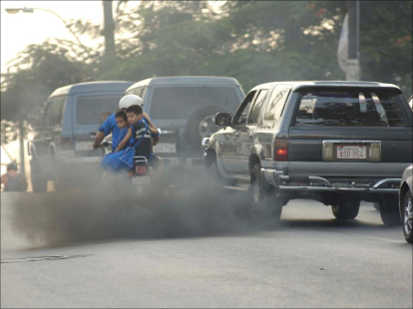
Air quality control in LAC
21/33 Air Quality Legislation
    Most of the countries have a general
    environmental law or decree, not AQ
23/33 Air Quality Standards
    Not following WHO AQG
Only 88 cities from 13 LAC* countries provide air quality monitoring data to the WHO Ambient Air Pollution database, compared to 535 cities in 4 High Income countries. (WHO, 2014a).
*21 countries have cities >=750,000 inhabitants (UN Habitat, 2012)
Notes:
21 countries in LAC have cities larger than 750,000 inhabitants (total of 81 cities)
Use of coal/ biomass adds a mean of 14% to ambient air pollution in poor countries in LAC

Slide 16
Solid fuel use, Latin America and the Caribbean, 1990-2010
Source: elaborated from data provided by Bonjour S et al., 2013

Slide 17
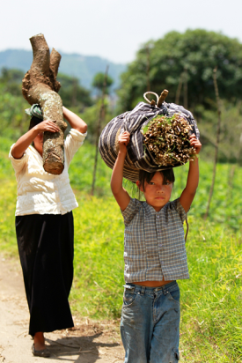
10% of the 35 countries in the Americas use solid fuels
47% of them, live in 6 countries (Guatemala, Haiti, Honduras, Nicaragua, Paraguay and Peru). These countries represent only 8% de la población de las Américas.
Almost no reduction in the percentage of SFU in the last 30 years in Guatemala, Haiti and Paraguay

Slide 18
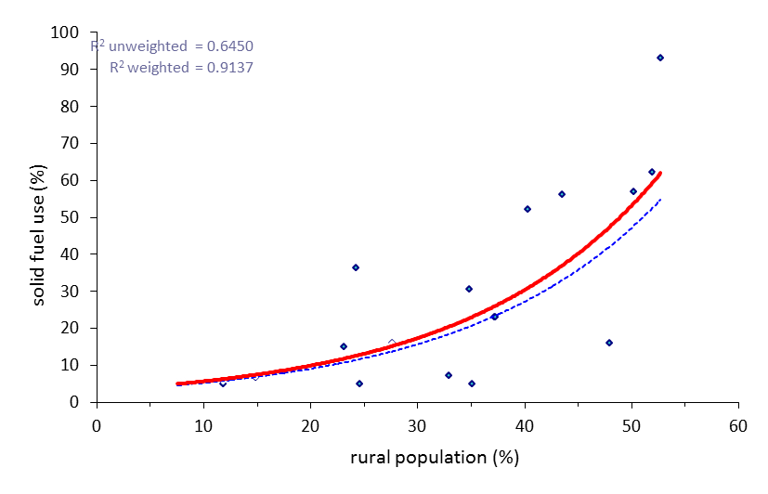
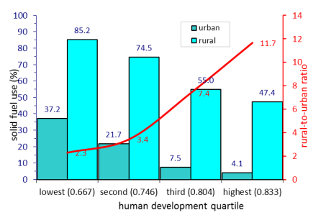
Rural x Urbano
Figura 2: Uso de combustibles sólidos en áreas urbanas y rurales en función del IDH en 21 países de América Latina y el Caribe
Figura 1: Uso de combustibles sólidos en función del tamaño de la población rural en 21 países de América Latina y el Caribe

Slide 19
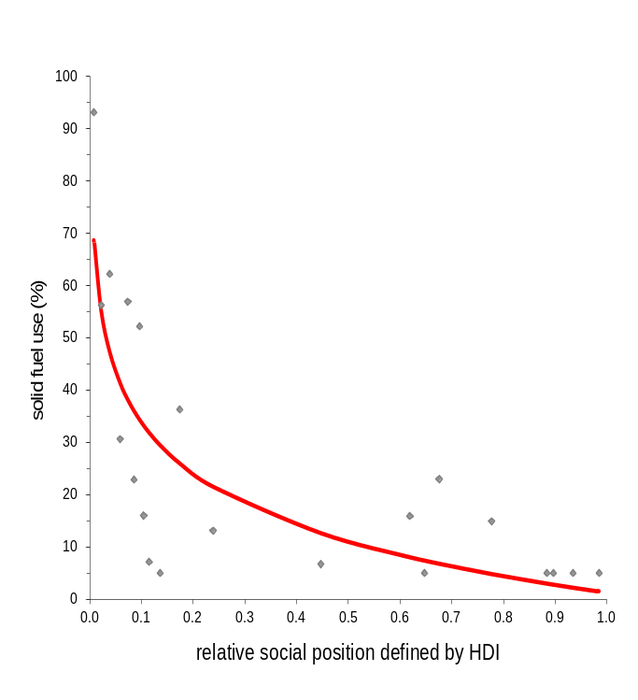
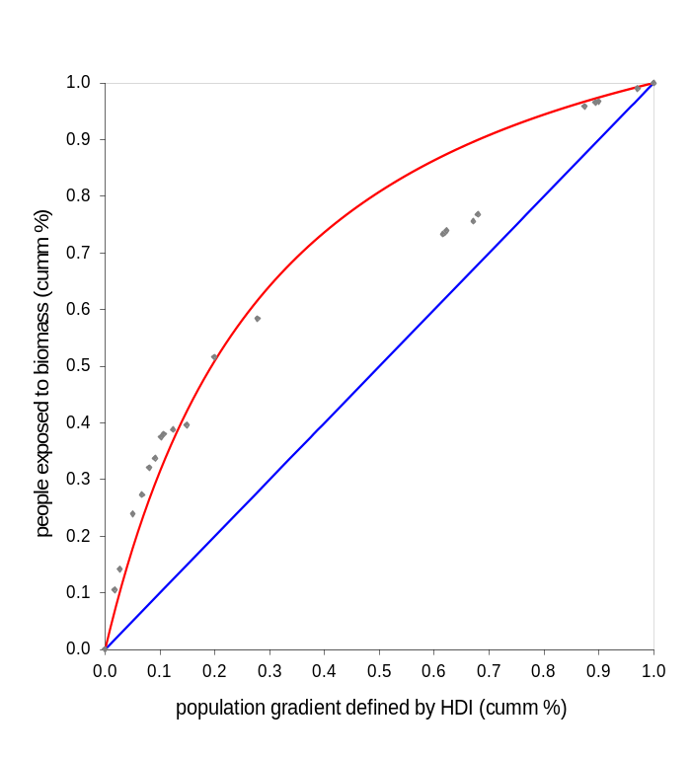
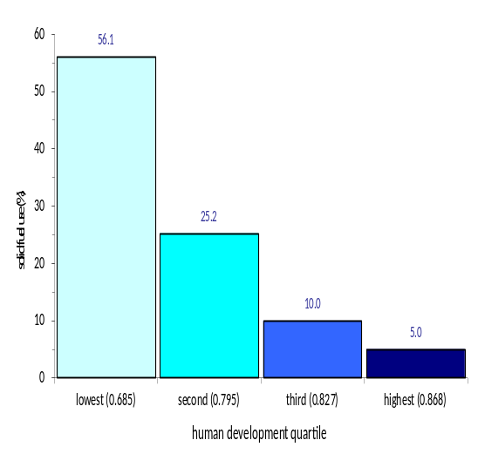
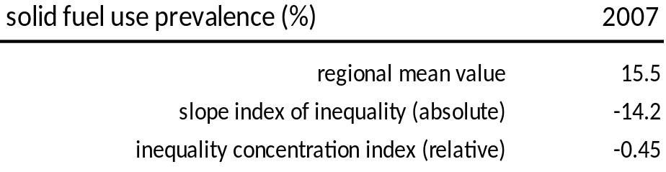
Regional inequalities in biomass exposure
according to a social gradient defined by human development
exploratory data analysis with disaggregation at the national level
health inequality gradient
health inequality regression line
health inequality concentration curve
Soares A, Meyer MA, Mujica OJ. Abstract 287890. APHA Meeting 2013
Notes:
18

Slide 20
Climate change impact on health equity

Slide 21
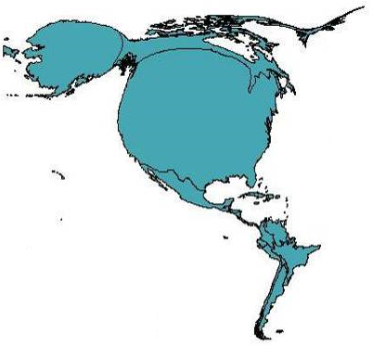
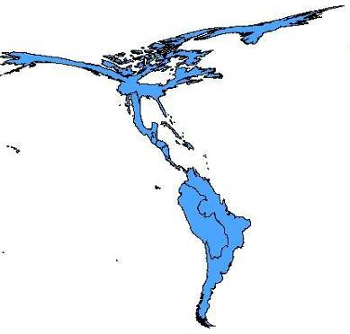
A regional inequality problem
greenhouse-effect gas emission
health impacts (attributable mortality)
Gibbs et al. Ecohealth: December 2007

Slide 22
Key facts
The risk of being affected by weather-related natural disasters is almost 80 times higher in developing countries.
The social determinants of health shape differential vulnerabilities to climate change
Climate change affects the social determinants of health (SDH). It also affects the enablers of sustainable development and human security.
The SDH affect the capacity for mitigation and adaptation.
Notes:
The risk of being affected by weather-related natural disasters is almost 80 times higher in developing countries than in developed countries. and nearly twice
The social determinants of health shape differential vulnerabilities to climate change
Climate change affects social determinants of health such as employment and work conditions, housing, and education. It also affects directly sustainable development and human security issues such as migration and food security.
The SDH affect not only the burden and the need to adapt to climate change, but also the capacity for mitigation and adaptation.

Slide 23
Take home messages: challenges and opportunities

Slide 24
Climate Change and Health Equity
National plans on climate change should address the impact of climate change on health inequities
Use an equity-sensitive health impact assessment (HIA) framework as a decision support tool.
Increase the evidence-base for action
Notes:
National plans to assess the impact of climate change on health inequities, and incorporate intersectoral policies to address these inequities on mitigation and adaptations plans.
Considering the Rio Political Declaration on the Social Determinants of Health, as a consensual pro-health equity policy framework, use an equity-sensitive health impact assessment (HIA) framework as a decision support tool.
Increase the evidence-base for action: monitor, benchmark, and track progress on health outcomes using well defined target groups and disaggregated data of all interventions in climate mitigation and adaptation in various sectors (agriculture, energy, transport etc.).

Slide 25
Knowledge needed for effective policies
An inventory of the sources contributing to Air Pollution and climate change
Monitor health effects of interventions: sustainable transport, energy-efficient homes, clean cookstoves, and clean energy sources
Tracking of air pollution and related health impacts: local data to inform about trends and effectiveness of policy measures
PAHO/WHO supports the Climate Clean Air Coalition, and is working with UNEP to produce a Regional assessment of Short-Lived Climate Pollutants (SLCP), with focus on their health effects, and on health inequities.
Notes:
An inventory of the sources contributing to Air Pollution (power generation, transportation, home energy etc. varies between cities and regions)
Monitor health effects of interventions: sustainable transport, energy-efficient homes, clean cookstoves, and clean energy sources
Tracking of air pollution and related health impacts: local data to inform about trends and effectiveness of policy measures
PAHO/WHO supports the Climate Clean Air Coalition, and is working with UNEP to produce a Regional assessment of Short-Lived Climate Pollutants (SLCP), with focus on their health effects, and on health inequities.

Slide 26
The way forward
Implement the WHO Air Quality Guidelines
Urban health – integrated climate-air quality policies (healthy housing, public transportation, clean air, etc.)
Whenever possible, replace “ dirty fuels” with “ cleaner fuels” for cooking and heating/ cleaner technologies.
Focus on policies/investments most beneficial to health and equity
Strengthen the implementation of SMART health services

Slide 27
Thank you!
Contact: soaresag@paho.org

