Slide 1



François Houllier
CEO of French National Institute of Agronomical Research
Health and Climate change
12/04/2015

Slide 2


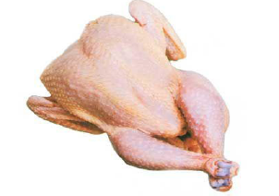
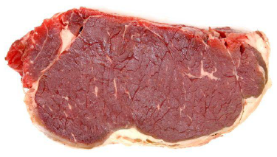
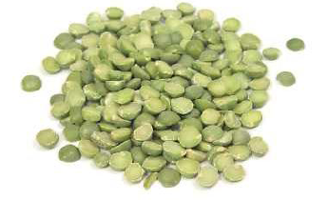
Animal versus plant-base diets and GHG emissions
High GHGE of animal products vs plant-based ones
GHGE
(kg CO₂ eq./kg)
Plant-based diets recommended for health
Sustainable diets : lower energy density without increasing quantities

Slide 3
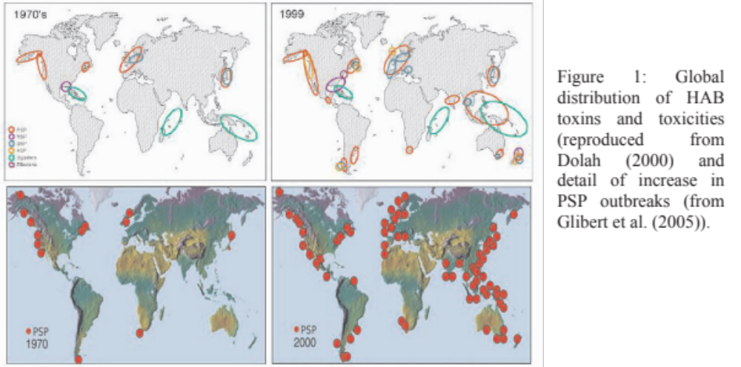
Human Health
From : Climate change: implications for food safety (FAO, Rome 2008)

Slide 4
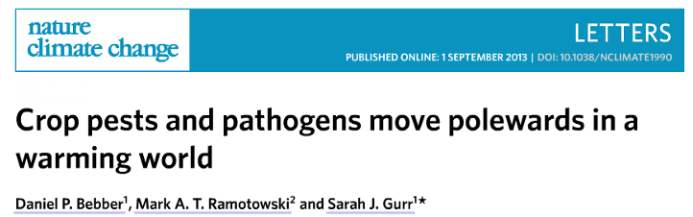
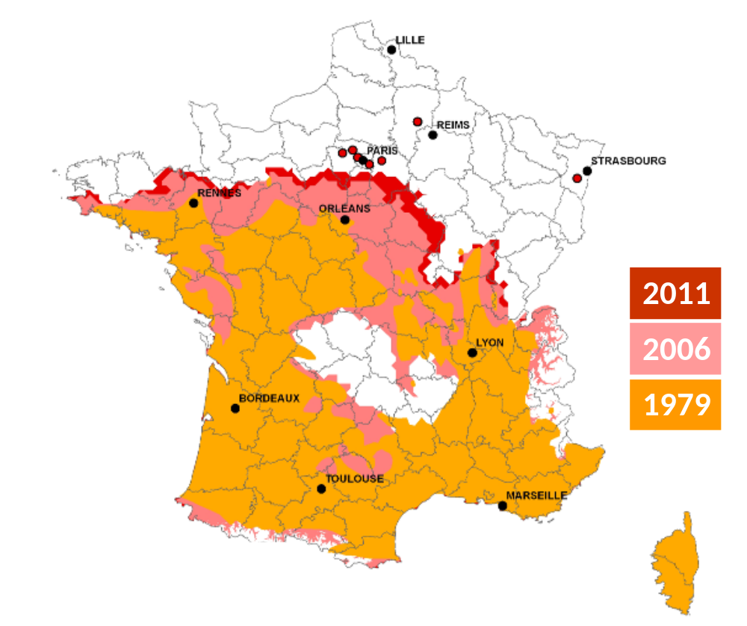

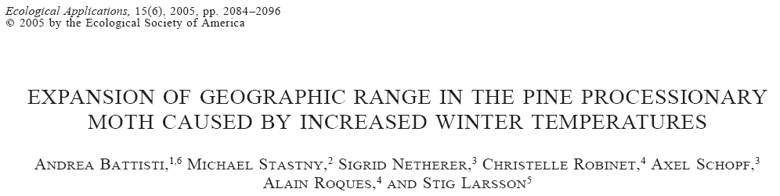
Forest health

Slide 5
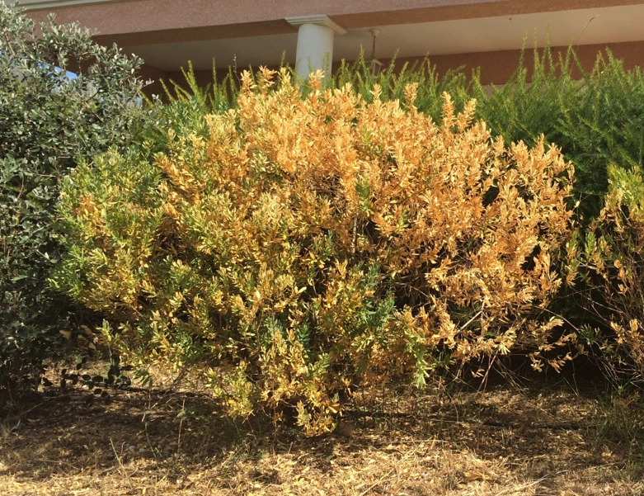
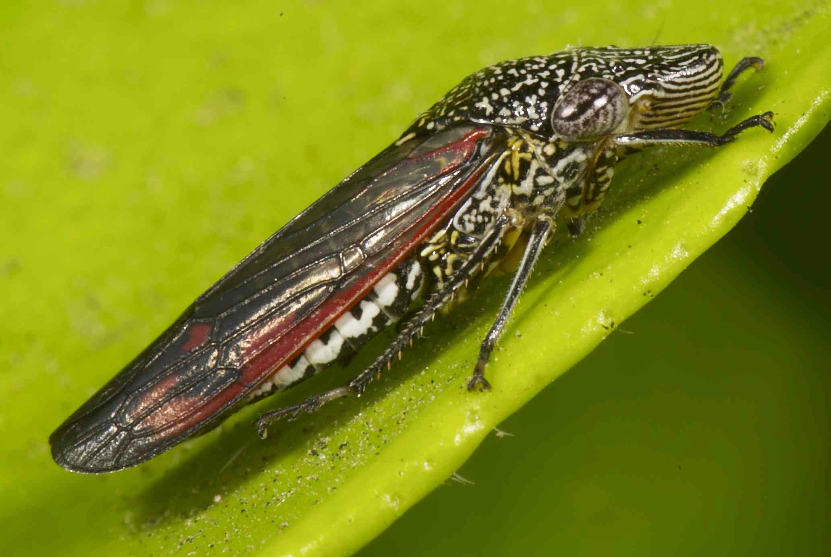
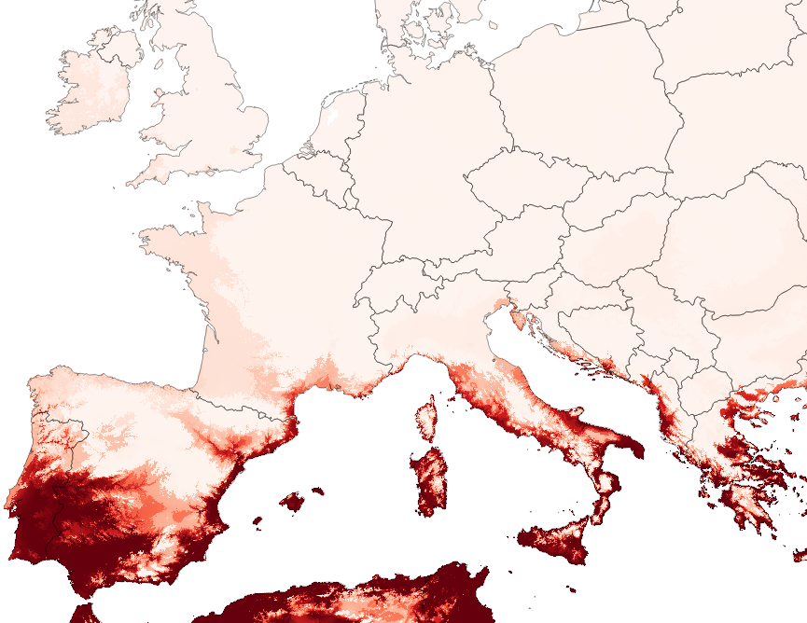
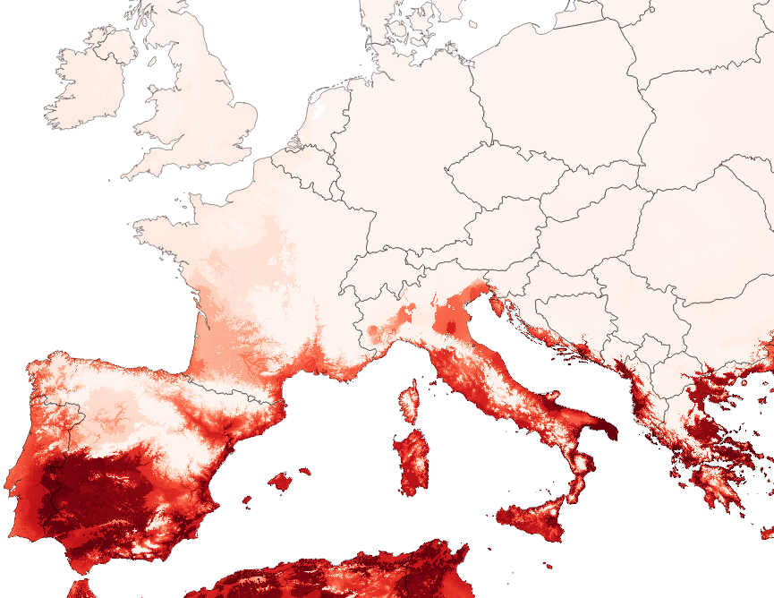
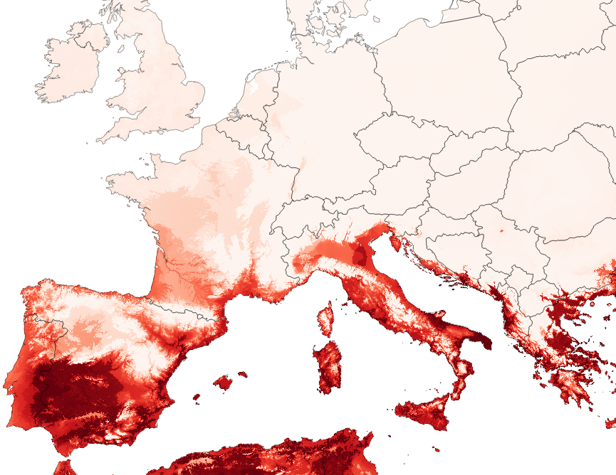
An introduction scenario : potential distribution area of a disease vector under current climatic conditions, in 2050 and in 2070
Homalodisca vitripennis
2070
2050
JP Rossi, JY Rasplus, INRA CBGP

Slide 6
Thank you for your attention

