Slide 1
Introduction to climate change and health
Kristie L. Ebi, Ph.D., MPH
University of Washington
Climate and Health Summit 2014: Investing in Health
6 December 2014

Slide 2
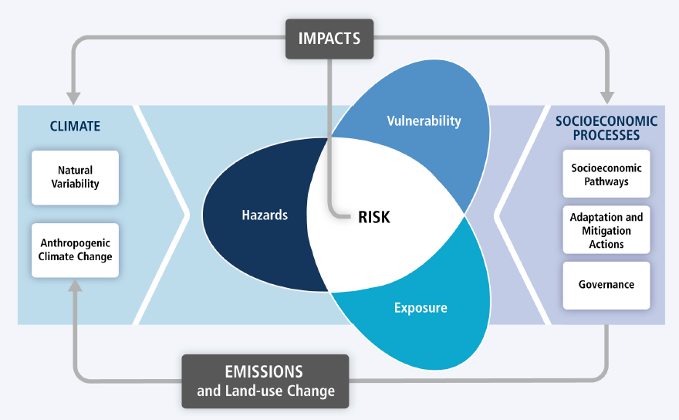
IPCC 2014

Slide 3
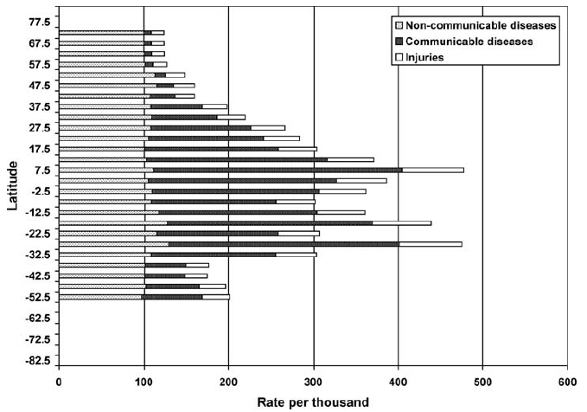
Sum of years of life lost and years of life lived with disability
Annual deaths:
Diarrheal diseases = 760,000
Malaria = 490,000 - 836,000
Malnutrition is an underlying
cause of 50% of the 6.6
million annual childhood deaths
Pitcher et al. 2008

Slide 4
CLIMATE CHANGE
Natural and
anthropogenic
Climate change and impacts on human health
Adaptation & Mitigation
Hazards due to climate variability and change
Extreme weather
Precipitation
Temperature
Sea level rise
Critical
PATHWAYS
Transmission
Dynamics
Population
Displacement
Contamination
Pathways
Ocean
Acidification
Air Pollution &
Aeroallergens
Examples of HEALTH EFFECTS
Temperature
related
Extreme Weather related
Food & Water
Borne Disease
Vector & Rodent Borne Disease
Air Pollution related
Examples of
HEALTH
INDICATORS
Heat Related
Deaths
Extremes-related
Population
Displacement
Vibrio
Infection
Hanta Virus
Asthma
and COPD
Determinants
of
RISK
PREDICTION and PREVENTION
RESPONSE STRATEGIES
Adaptation & Mitigation
Vulnerability
Exposure
MODERATING
(Non-climate) FACTORS
Socioeconomics
Infrastructure
Land use change
Ecosystem services
Adaptation & Mitigation

Slide 5
IPCC human health chapter: what is familiar
Health is sensitive to shifts in weather patterns and other aspects of climate change
Climate change is already adding to the burden of disease and illness, world-wide
Most vulnerable are those whose health is most affected by the present day climate
Largest risks: undernutrition, extreme weather events, and infectious disease

Slide 6
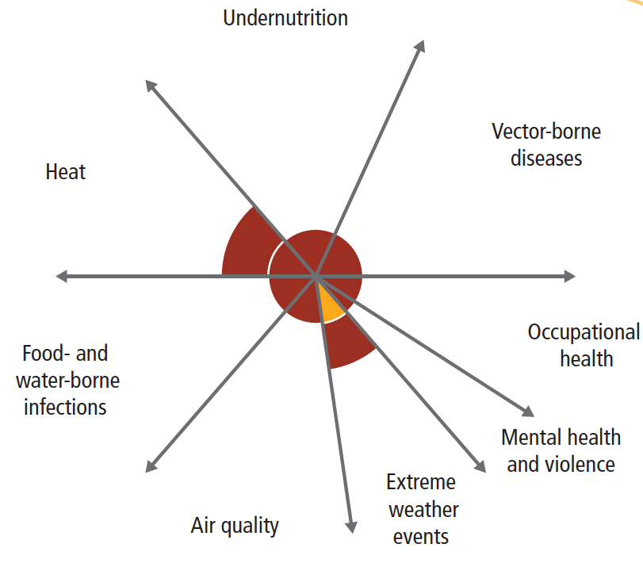
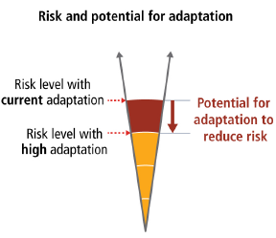
Current health impacts of climate change
Smith et al. 2014

Slide 7
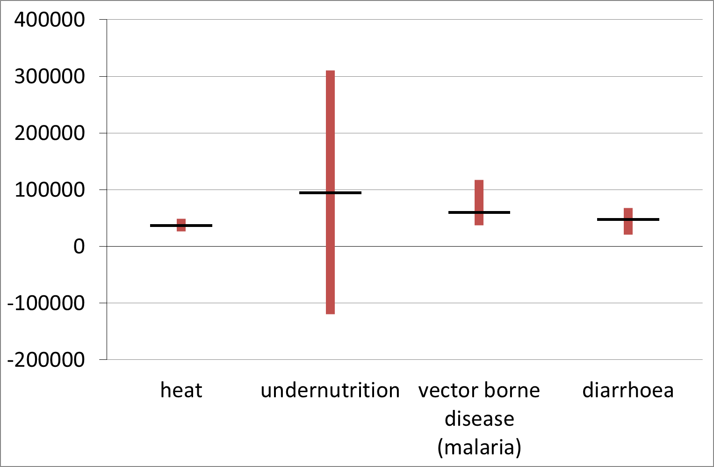
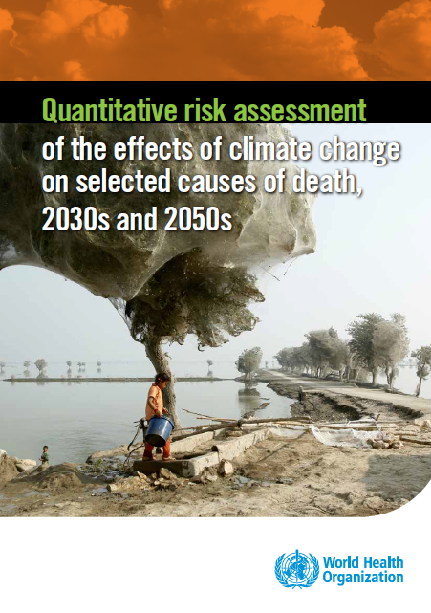
Estimates of mortality due to climate change, 2030s: approximately 250,000 excess deaths/year
WHO 2014
Notes:
All results are for SRES A1b emissions and a baseline socioeconomic scenario in which GDP projections account for World Bank revisions to purchasing power parity conversion rates and recent projections of real growth per annum in income per capita (World Bank, IMF and OECD).
Mortality trends in the absence of climate change are projected based on empirical models (note projected substantial decline in background rate of communicable diseases for 2030s and 2050s).
For heat (age >65 years), diarrhoea (<15 years) and malaria: central estimate is mean of 5 alternative global climate model runs: BCM2.0; EGMAM (3 runs); and CM4v1; range=highest and lowest results;
For undernutrition (age <5 years): MIROC and CSIRO Mk3; range is +/- 1 s.d. Of impact pdf; negative values represent mortality improvement

Slide 8
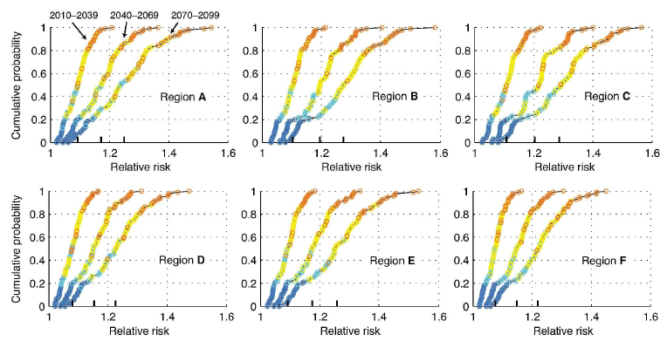
Risk of diarrheal disease with climate change
South America
North Africa
Middle East
Equatorial Africa
Southern Africa
Southeast Asia
Kolstad 2011

Slide 9
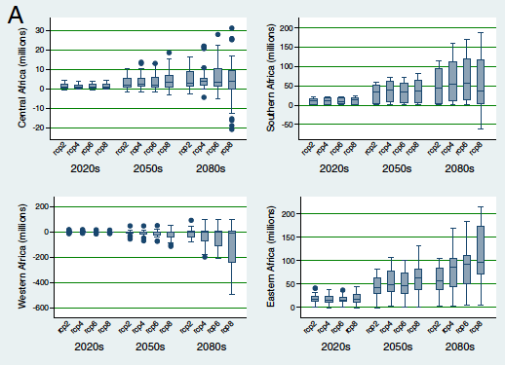
Projected population at risk of malaria due to climate change
Caminade et al. 2014

Slide 10
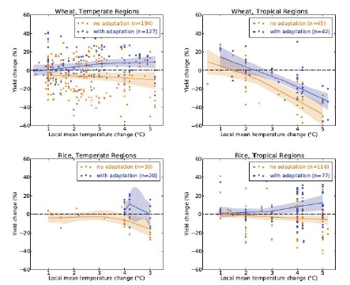
%age simulated crop yield change as a function of local temperature change
IPCC 2014

Slide 11
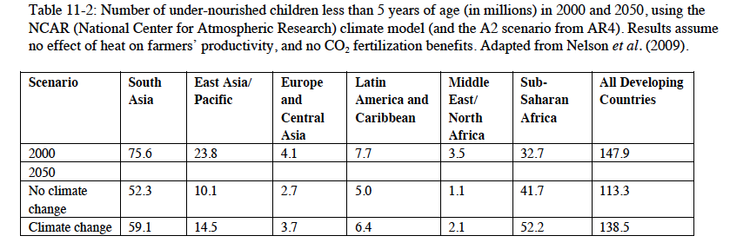
IPCC 2014

Slide 12
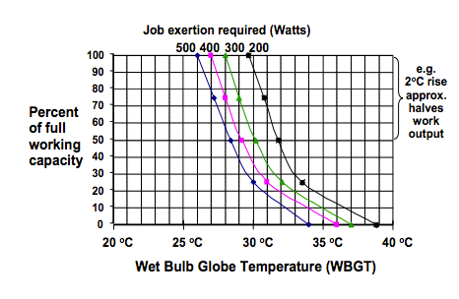
Work and heat
In Southeast Asia, in 2050, more than half the afternoon work hours may be lost due to the need for rest breaks – IPCC, 2014
Slide courtesy of Alistair Woodward, Tord Kjellstrom

Slide 13
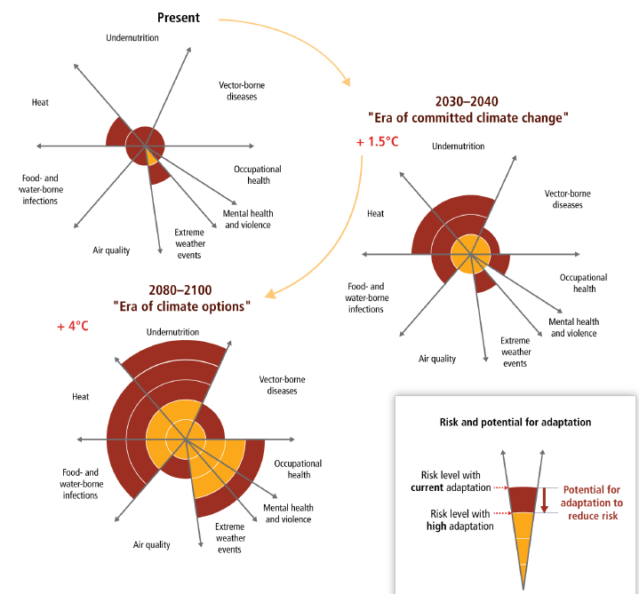
IPCC 2014

Slide 14
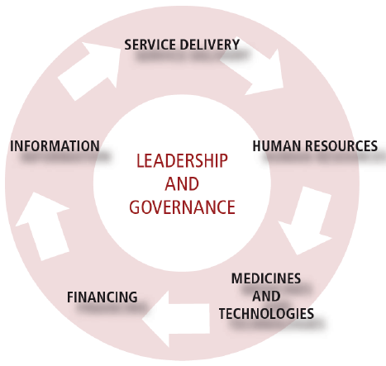
Reduce exposures
  Legislative policies
  Alterations in built environment
  Alterations in natural environment
Prevent onset of adverse outcomes
  Early warning systems
  Surveillance and monitoring
  Vector control programs
  Public education and outreach
Response / treatment
  Medical training and awareness
  Treatment
  Emergency response

Slide 15
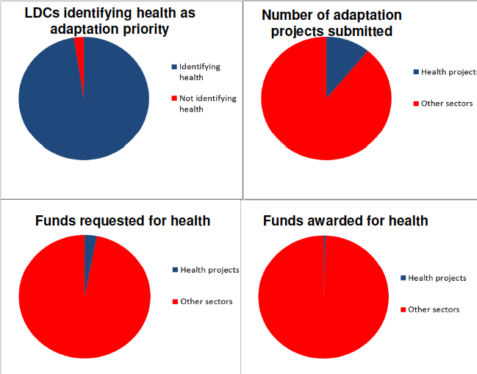

Slide 16
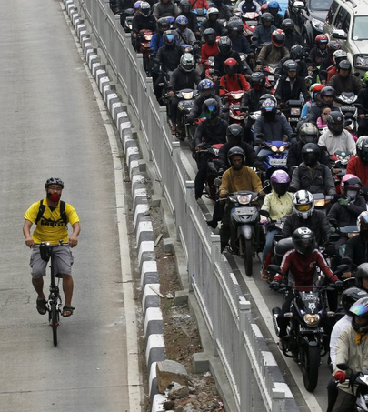
Co-benefits – early health gains from wise climate moves
Shifting 5% of short urban car trips to bicycles in New Zealand would save annually
22 million liters of fuel
116 deaths due to increased physical activity (vs. 5 extra road crash deaths)
$200 million in health costs
ANZJPH 2011

Slide 17
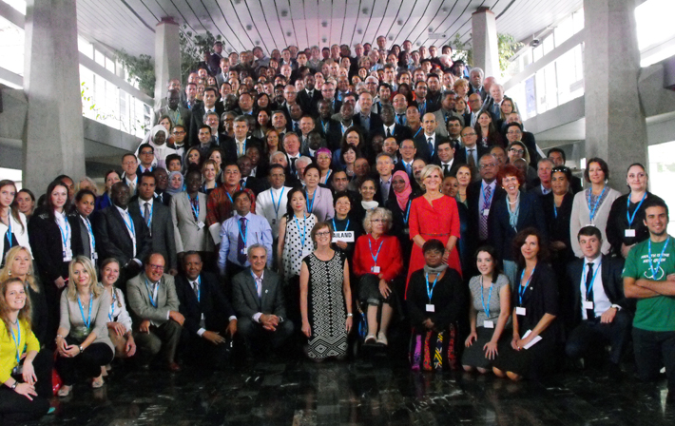
WHO Conference on Health and Climate, August 2014

Slide 18
Scenario matrix architecture
 |  | SSP 1 | SSP 2 | SSP 3 | SSP4 | SSP5
 | Reference | X | X | X | X | X
RCP Replication | 8.5 Wm⁻² |  |  | X
 | 6.0 Wm⁻² |  | X | X | X | X
 | 4.5 Wm⁻² | X | X | X | X | X
 | 2.6 Wm⁻² | X | X |  | X
SPAs
Van Vuuren et al. 2013

Slide 19
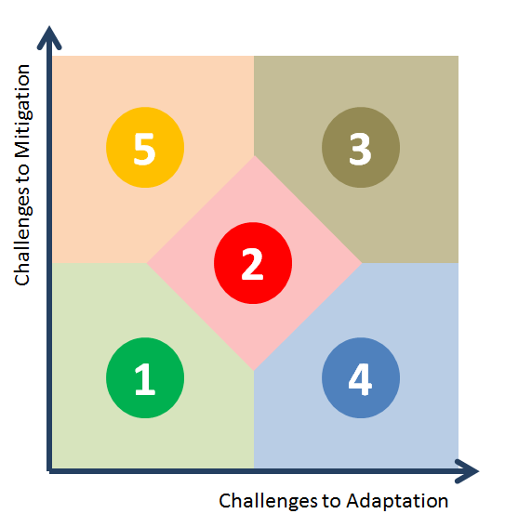
Shared socioeconomic pathways
Fossil-fueled development
Regional
rivalry
Sustainability
Inequality
O’Neill et al. 2013

Slide 20
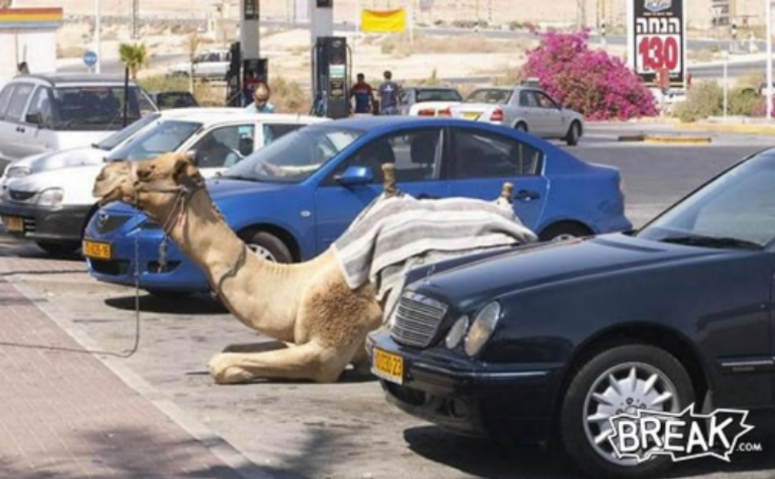
It is not the strongest of the species that survives, nor the most intelligent that survives. It is the one that is most adaptable to change.
Charles Darwin

