Slide 1

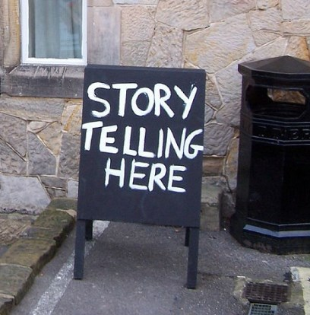
Notes:
-- Sophisticated, knowledgeable audience
-- A powerful story does change everything
-- Here are four examples

Slide 2

Teaching us that smoking kills

Slide 3
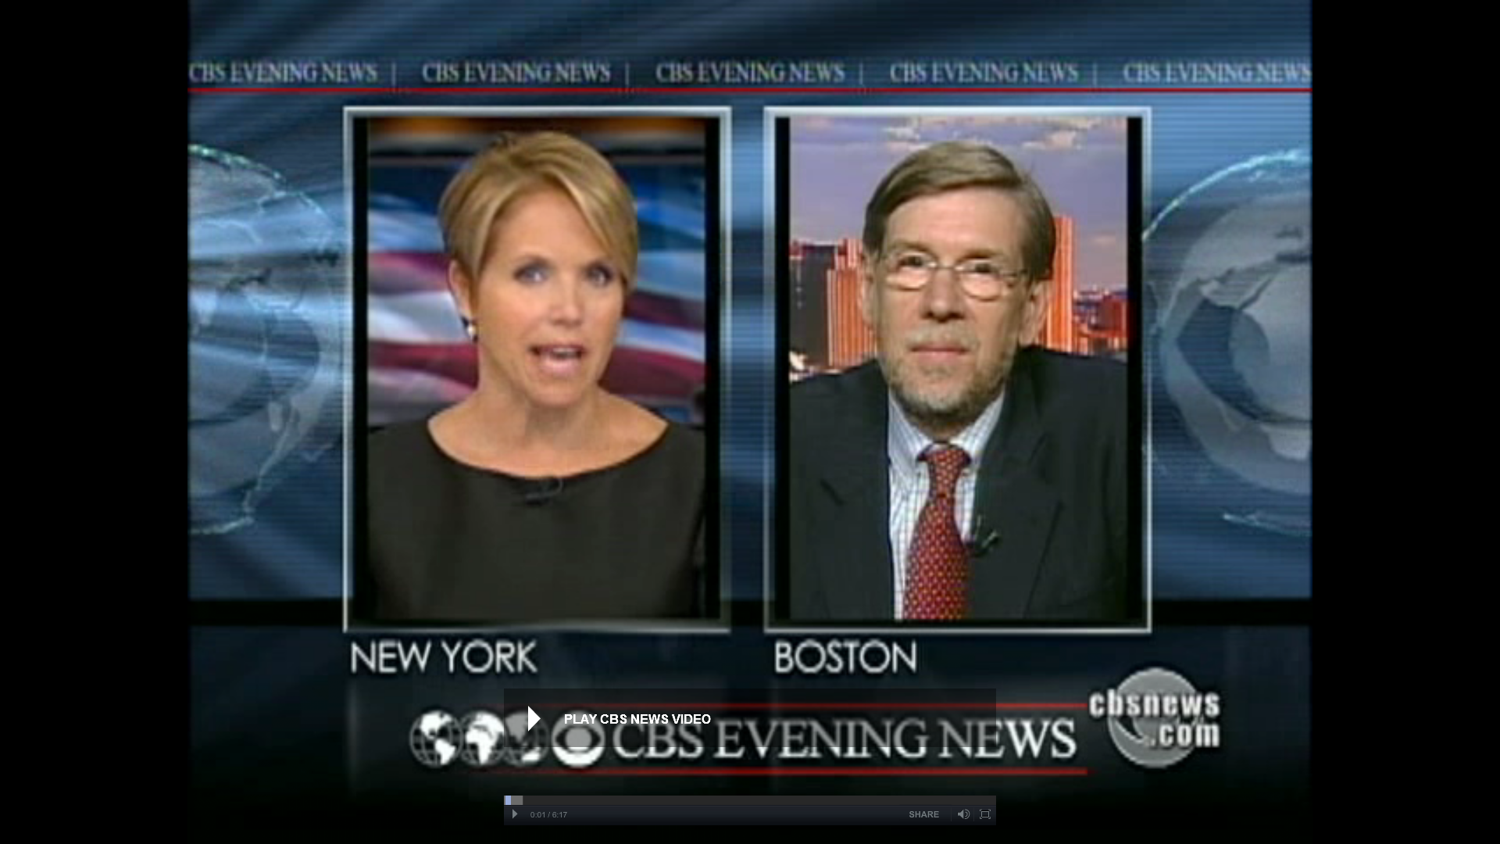
Tobacco Wars
Notes:
-- Until FDA took on tobacco, we didn’t know certain things
-- Nicotine addition begins for many with the first 10 cigarettes
-- Why 10 packs given to children on school playgrounds
-- Recent studies show nicotine receptors increase after just 2 doses

Slide 4
Science always wins…eventually
We had to make four things crystal clear for the American public:
1. Nicotine is addictive, and the addiction process begins with just a few cigarettes.
2. Tobacco companies knew this, and targeted children.
3. Cigarettes are a highly engineered product, designed to deliver doses of nicotine.
4. They had the most sophisticated marketing expertise in history.

Slide 5
Talking about events in the distant future is almost worthless.

Slide 6

Scaring teenagers about smoking never worked

Slide 7
Changing the Climate Story
Clear, simple messages repeated often by trusted sources
1) It’s about people, not polar bears.
2) We’re seeing climate impacts now … not 50 years from now.
3) The science debate is over.
4) Most of us understand that something is happening on our planet.
5) You can’t talk about solutions without acknowledging the threat.

Slide 8
Making the Climate-Health Link
Powerful, non-environmental voices will change the issue immediately
Four critical communities: National security, faith, business and health.
Of these, the health community may be the most important.
People care about health impacts more than anything else on earth.
But the health community has been slow to take on the issue.
It needs to lead, not follow.

