Slide 1


Climate Change,
Energy Policy and Health
COP21 Paris, Dec. 5, 2015
Jonathan Patz, Professor & Director

Slide 2
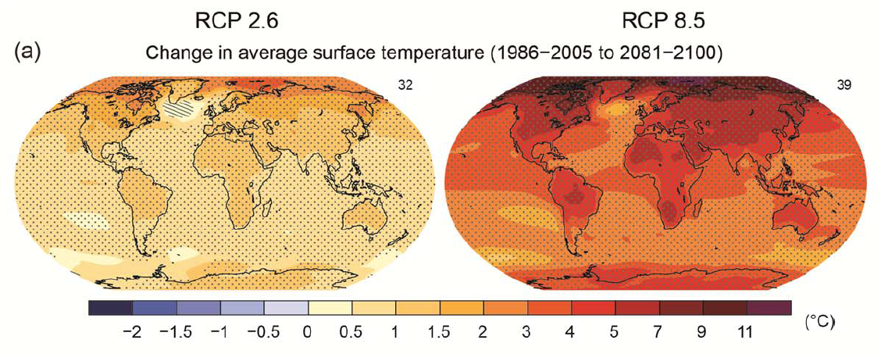
Future Projections
Range: from 1 – 7°C average global warming by 2100
IPCC, AR5, 2013
Notes:
1-5 degrees represents the range of warming for the RCP4.5 pathway. The range from the RCP2.6-RCP8.5 pathways is more like 1-7C.
Figure SPM.8: Maps of CMIP5 multi-model mean results for the scenarios RCP2.6 and RCP8.5 in 2081–
2100 of (a) annual mean surface temperature change, (b) average percent change in annual mean
precipitation, (c) Northern Hemisphere September sea ice extent and (d) change in ocean surface pH.
Changes in panels (a), (b) and (d) are shown relative to 1986–2005. The number of CMIP5 models used to
calculate the multi-model mean is indicated in the upper right corner of each panel. For panels (a) and (b),
hatching indicates regions where the multi-model mean is small compared to internal variability (i.e., less
than one standard deviation of internal variability in 20-year means). Stippling indicates regions where the
multi-model mean is large compared to internal variability (i.e., greater than two standard deviations of
internal variability in 20-year means) and where 90% of models agree on the sign of change (see Box 12.1).
In panel (c), the lines are the modelled means for 1986−2005; the filled areas are for the end of the century.
The CMIP5 multi-model mean is given in white colour, the projected mean sea ice extent of a subset of
models (number of models given in brackets) that most closely reproduce the climatological mean state and
1979‒2012 trend of the Arctic sea ice extent is given in light blue colour. For further technical details see the
Technical Summary Supplementary Material. {Figures 6.28, 12.11, 12.22, and 12.29; Figures TS.15, TS.16,
TS.17, and TS.20}

Slide 3
HEALTH EFFECTS OF CLIMATE CHANGE
Urban Heat Island Effect
Air Pollution & Aeroallergens
Vector-borne Diseases
Water-borne Diseases
Water resources & food supply
Mental Health &
Environmental Refugees
Heat Stress
Cardiorespiratory failure
Respiratory diseases, e.g., COPD & Asthma
Malaria
Dengue
Encephalitis
Hantavirus
Rift Valley Fever
Cholera
Cyclospora
Cryptosporidiosis
Campylobacter
Leptospirosis
Malnutrition
Diarrhea
Toxic Red Tides
Forced Migration
Overcrowding
Infectious diseases
Human Conflicts
CLIMATE
CHANGE
Temperature Rise ¹
Sea level Rise ²
Hydrologic Extremes
¹ 3°C by yr. 2100
² 40 cm “ “
IPCC estimates
Patz, 1998

Slide 4
temperature
Climate Variability and Change

Slide 5
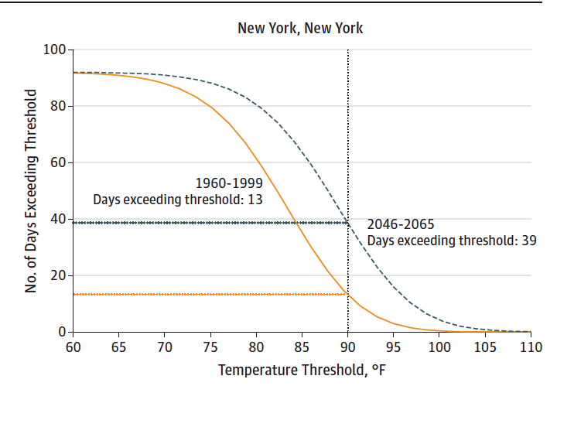
Projected # of days over 32°C
Average NYC summer (current) = 13 days
Average summer (2046-65) = 39 days
32°C
Patz et al. 2014
Notes:
Bottom line (but you might reach out to Dan) is that we used a downscaling technique that can capture the temperature extremes —by retaining mean and standard deviation in downscaling. New technique called “vector-based” generalized linear modeling.
Often downscaling climate models provide mean temperatures, but not retain climate extremes.
Finally, our findings are consistent with other analyses (including the National Assessment).
Unique: downscaled from the climate models, and “de-biased” de-biased
Here we do capture the extremes — predict mean and STD retain mean and STD in downscaling.
NEW technique to retain the extremes — vector-based generalized linear model ..for user
consistent and designed to retain …
East of the Rockies

Slide 6
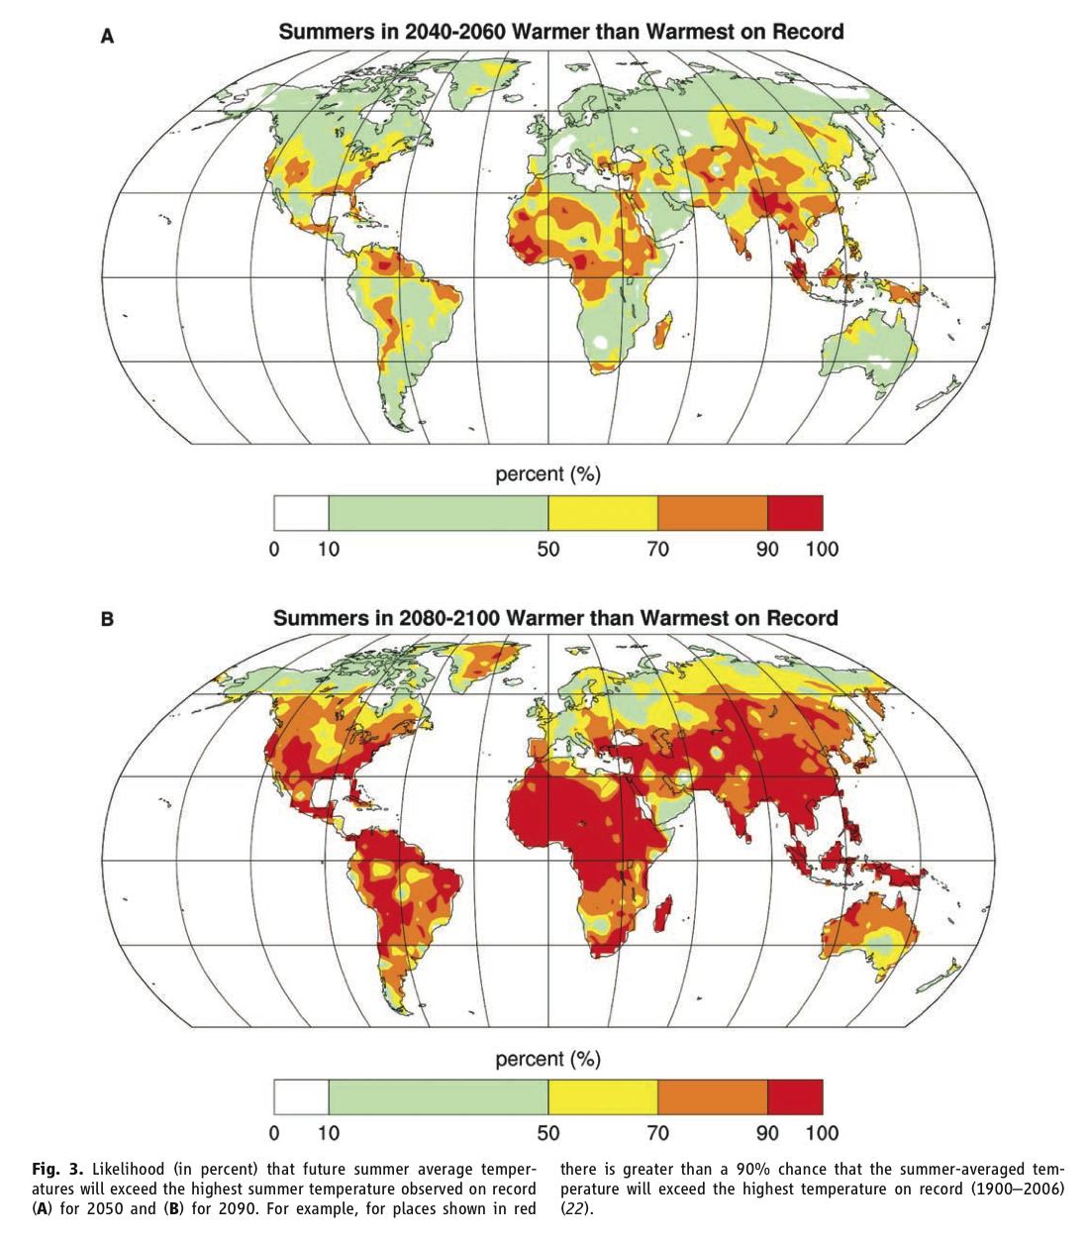
Future summers warmer than warmest on record
    Today’s 900 million at risk for hunger could double by mid-century.
Battisi and Naylor, Science 2009

Slide 7
precipitation
Climate Variability and Change

Slide 8
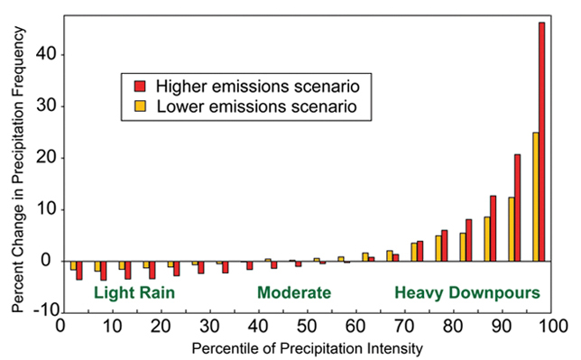
In Future, when it rains…it will pour.
By 2050, Chicago could see >100% increase in “Combined Sewage Overflow” (CSO) events (Patz et al. 2008)
Globally Averaged
U.S. CCSP, 2008

Slide 9
Lima COP 20: call for climate action:
Examples of “Intended Nationally Determined Contributions” (INDCs) to reduce greenhouse gas emissions:
  Japan: 26% below 2013 levels by 2030
  Australia: 26-28% below 2005 levels by 2030
  USA: 32% below 2005 by 2030
  EU: 40% below 1990 levels by 2030
  Ethiopia: 64% below BAU scenario by 2030
While these seem like daunting pledges, from a PUBLIC HEALTH perspective, the higher the pledge, the more profits for that country. Why?

Slide 10
Could Policy to Combat Climate Change be cost-free?
PUBLIC HEALTH co-benefits could even make climate change policy a net gain.

Slide 11
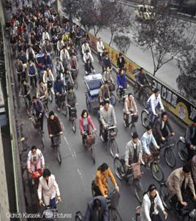
The opportunity to avoid:
8.0 million deaths/yr. from air pollution WHO and the Global Burden of Disease Report, 2013.
Cardiovascular risk from high meat diet.
3.2 million deaths/yr. from physical inactivity
Notes:
Many people are therefore considering how we can reduce these CO2 emissions.
But this is not just about protecting the environment, but also about improving health.
The main barrier to reducing greenhouse gas emissions is that it is argued to be expensive. This is particularly important for rapidly developing economies such as China and India, who have said that they will put improving the conditions of their own populations before climate protection.
But we can show that action on climate change provides "co-benefits" to health.
The IPCC concludes that the costs of climate change mitigation would largely be compensated by health gains from reduced air pollution alone.
And the benefits could be wider. Consider the fastest growing sector, transport. Urban planning that provides safe opportunities to walk and cycle and use mass transit, and cleaner fuels, could also help address some of our other largest public health burdens.

Slide 12
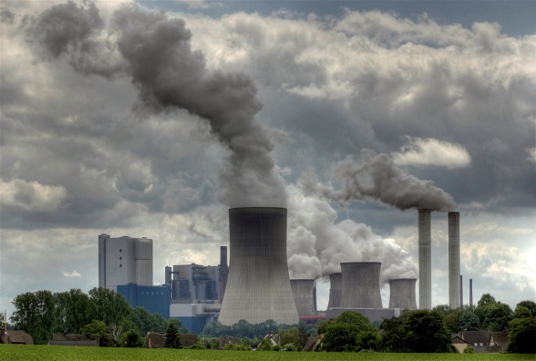
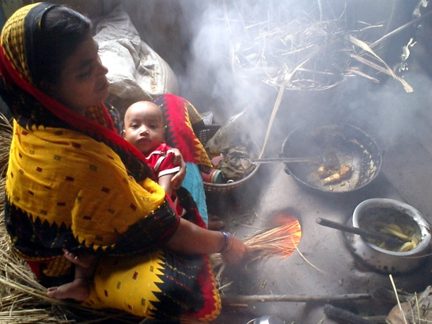
Current health impacts of fossil fuel combustion (main cause of climate change)
Outdoor air pollution → 3.7 million deaths/yr – mostly from urban exposures
Indoor air pollution → 4.3 million deaths/yr – mostly from inefficient biomass and coal cookstoves
Courtesy: D. Campbell-Lendrum, WHO
Notes:
Climate change is mainly caused by combustion of fossil fuels.
The same combustion also causes very large health impacts.
Together, air pollution responsible for about one in 8 deaths globally.

Slide 13
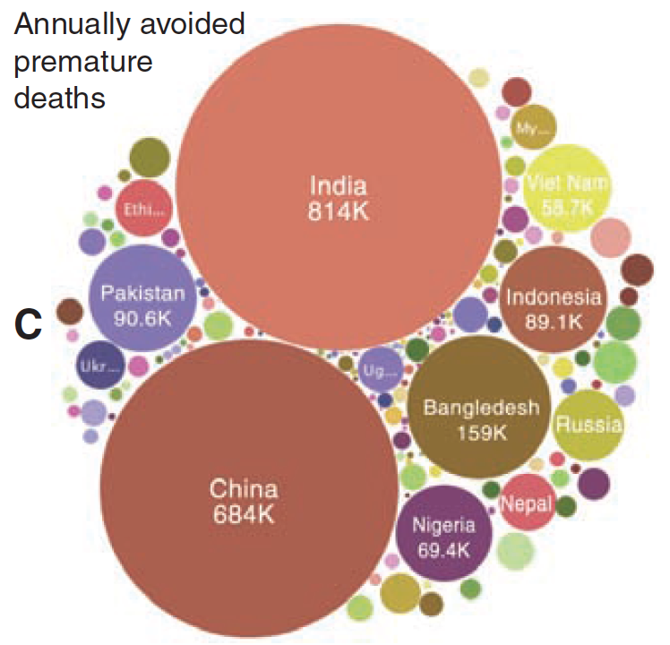
Co-benefit of up to 4 million deaths/yr.
Reductions in PM pollution in 2030
Shindell….J Schwartz… et al. Science, 2012
Notes:
control measures and identified 14 that both mitigate warming and improve air quality, such as reducing emissions from coal mining, oil and gas production, and municipal landfills.

Slide 14
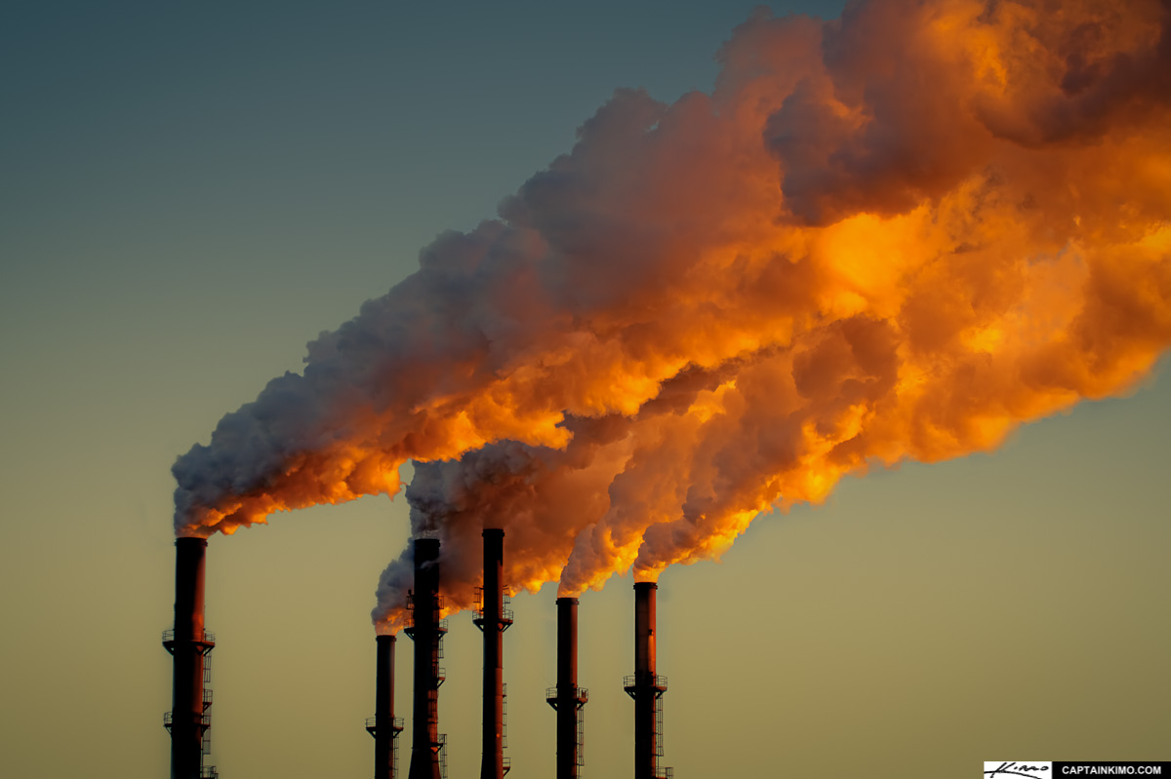

Cost of cleaner energy:
< $30/ tCO₂
Benefits of cleaner energy:
$200*/ tCO₂
WHICH NUMBER IS BIGGER???
(* Range: $50 to $380)
For E. Asia, co-benefits are 10 to 70 times greater
West et al. 2013

Slide 15
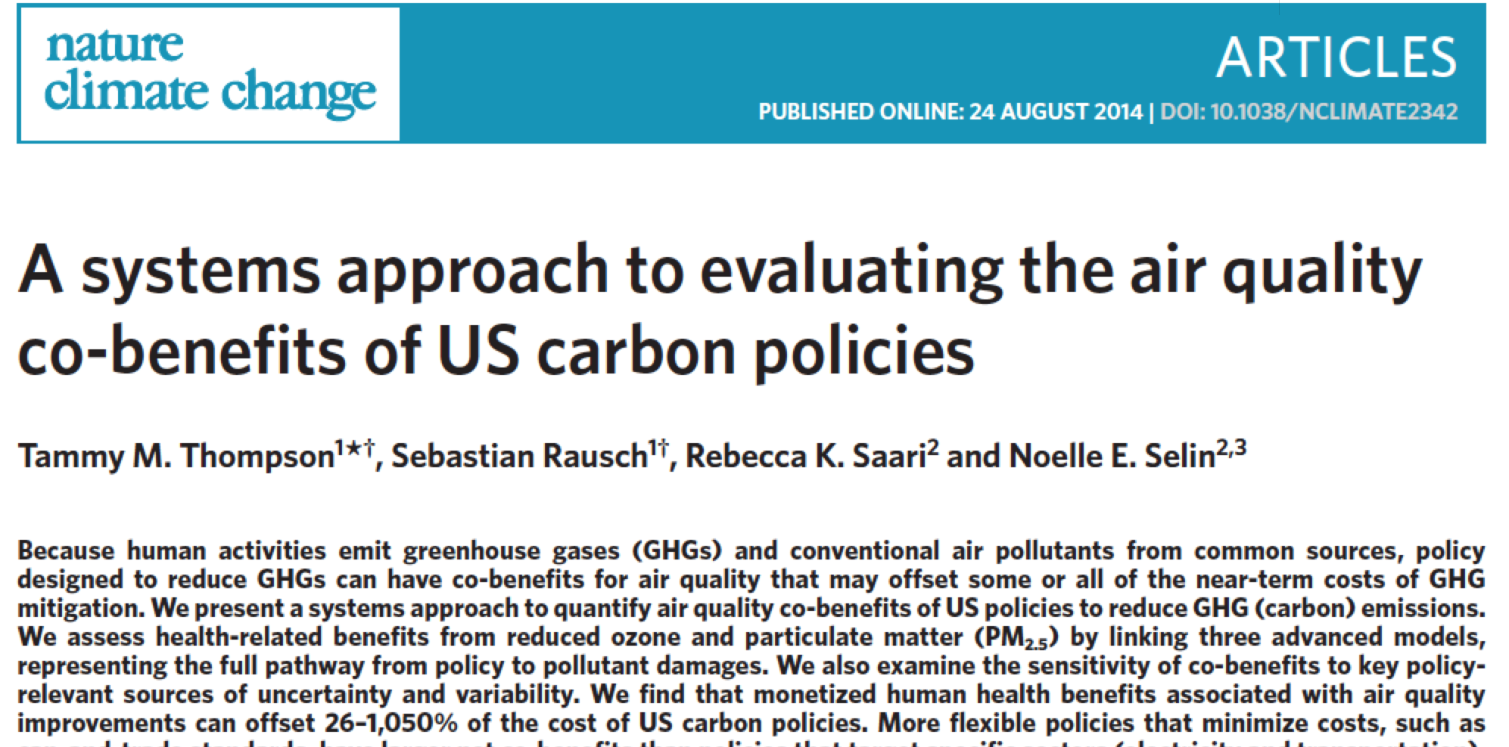
“…health benefits…can offset 26-1050% of the cost of US carbon policies”

Slide 16
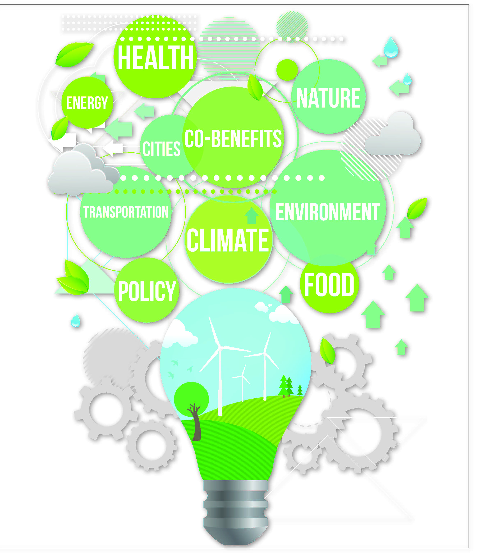
UW-Madison Massive Open Online Course:
“Climate Change Policy and Public Health”
Open until Dec. 31, 2015
Led by Jonathan Patz
Professor and John P. Holton Chair
To register for the MOOC:
FOR CASE STUDIES, TODAY’S PANELISTS:
Dr. Bayazit Ilhan, President of the Turkish Medical Association
Ms. Weronika Piestrzyńska, Communications Adviser (Coal and Health), HEAL Poland
Dr. Renzo Guinto, Coordinator, Health Care Without Harm Asia
Dr. K. Srinath Reddy, President of the Public Health Foundation, India
https://www.coursera.org/course/ccandph

