Slide 1
Climate and Health Summit,
Paris, France
December 5, 2015

Slide 2
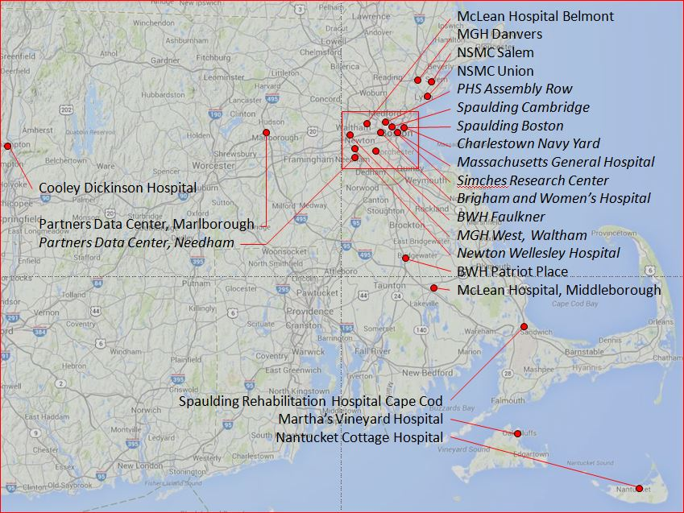
Partners HealthCare
4M OUTPATIENT VISITS
150,000 INPATIENT STAYS
60,000 EMPLOYEES
17.3M SQUARE FEET OF OWNED/LEASED SPACE
PRIMARY TEACHING AFFILIATE OF HARVARD MEDICAL SCHOOL

Slide 3
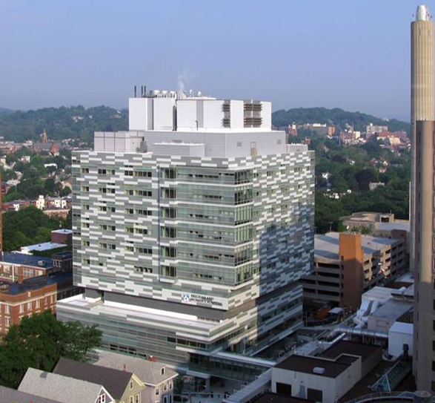
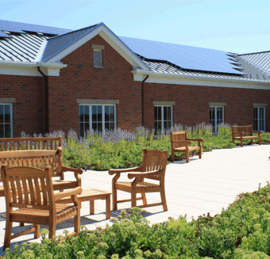
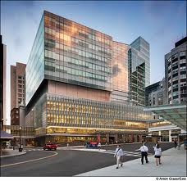
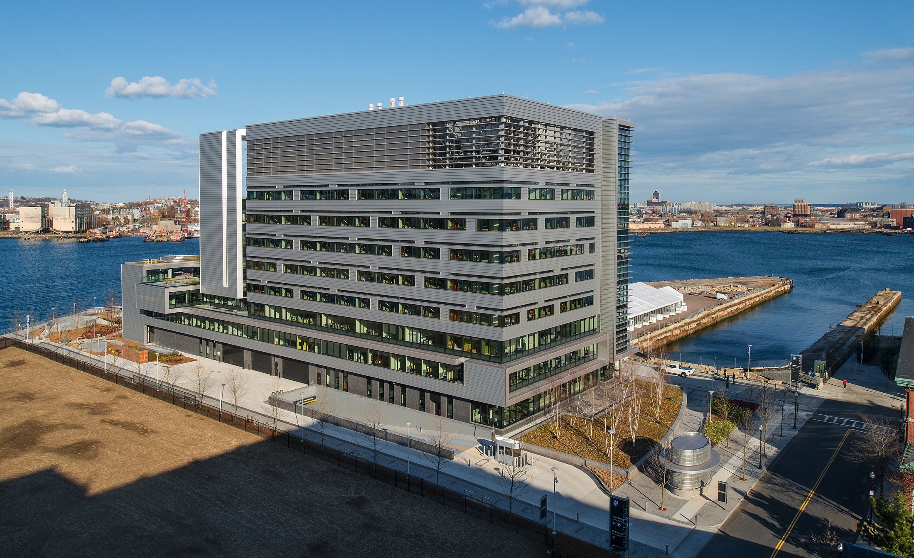

Sustainability History
Cost containment - high performance facilities New buildings - lower energy, improved indoor air quality
Brigham and Women’s Hospital Shapiro Cardiovascular Center | Martha’s Vineyard Hospital | Massachusetts General Hospital Lunder Building | Spaulding Rehabilitation Hospital Charlestown Navy Yard | North Shore Medical Center (North Shore Central Utility Plant)
136 beds LEED Silver 2008 | 25 beds LEED Gold 2010 | 150 beds LEED Gold 2011 | 132 beds LEED Gold 2013 | Combined Heat and Power System that provides steam, heat, hot water, sterilization, and electricity for all 640,00 square feet (465 beds) LEED Gold 2014
1.5 million sq. ft. of LEED Silver and Gold facilities built since 2008 Energy efficiency up to 32% better than ASHRAE 90.1 2007

Slide 4
Sustainability Strategy-1st iteration
Patient and Employees
Healthy Environment
Resources
Goals | Partners recognized as an aspirational brand High quality professional care Employee, patient and community engagement | Support and maintain a safe and healthy environment for our neighborhoods and future generations | Manage costs and leverage resources Return on investment Management of social and environmental risk for a competitive advantage
Methods | Communication and Collaboration Develop and strengthen relationships with entities and departmental stakeholders Provide advice and support in designing and implementing solutions | Performance Develop an empowered workforce and a culture embedded with sustainable principles Leverage technology, tools, and information | Strategy and Opportunities Integrate programs with clinical and operational activities Pilot programs Standard specifications
Tasks & Deliverables | Program Management Leadership and management Policies, templates and processes Communications, training and development Audit, review and report performance | Environmental Management Greenhouse gas emissions Energy management Waste management Water management Chemicals Transportation Environmentally preferred purchasing policy | Innovation Research Stakeholder partnerships Sustainable development within healthcare (Food, Nutrition, exercise…)

Slide 5
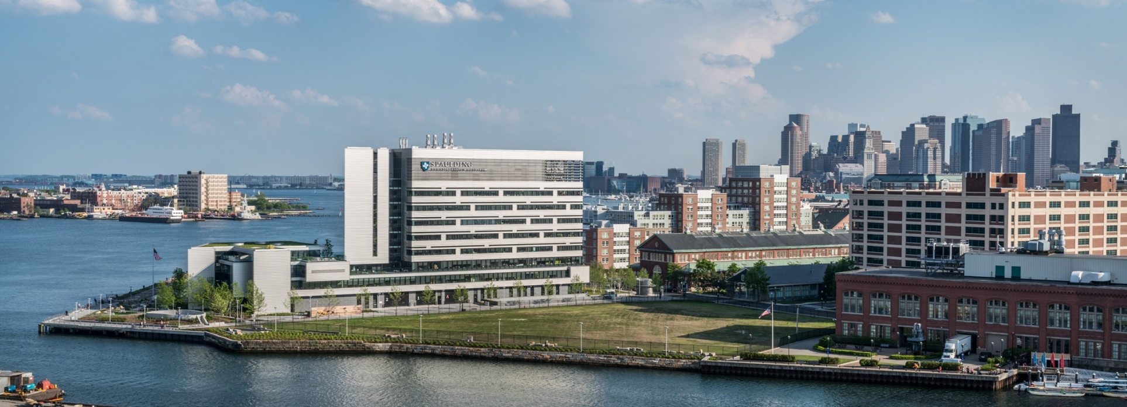
Spaulding Rehabilitation Hospital
The Spaulding Rehabilitation Hospital is located in the Charlestown Navy Yard on a revitalized brownfield site.
This landmark project embodies the Partners HealthCare mission of holistic wellness, including the buildings we occupy.

Slide 6


Resiliency - The Process
STEP 1
STEP 2
STEP 3
Climate Scenarios
Low Medium High
Prioritize Risk
Adaptation Strategies
Low Medium High Very High
Implications
Time Horizons
Identify Critical Facilities and Operations
Vulnerability & Risk Assessment
Prioritize Need Across System
Facility Resilience
Short-term Adaptation
Operations Impact
Capital Prioritization
Long-term Adaptation
Phase 1
Phase 2

Slide 7
Thank you
Monica Nakielski, Program Manager Sustainable Initiatives
Partners HealthCare
mnakielski@partners.org
(617)-643-7786
http://www.partners.org/Innovation-And-Leadership/Sustainability

