Slide 1
What can public policy do to deliver a sustainable and healthier future?
What needs to be accelerated over the next 5 years in the context of SDGs?
Solutions for a post-2015 world
Climate and health summit, Paris, 2015
Dr. Sania Nishtar
Heartfile, Pakistan

Slide 2
Lessons from the MDGs, about the power of such frameworks?
Transformed political agendas
Placed health higher than health ministries
Forged inter-sectoral collaboration
Platform for government-civil society and donor partnerships
Acted as consensus building tools
Provided a ‘rallying point’ for domestic and donor fiscal inputs in support of a set of time-bound outcome based targets
Forged policy consistency
Served as instruments of debt relief

Slide 3
Changes, post 2015
A shift in responsibility for development from donors to countries
A change in development thinking from vertical targets to building, systems, institutions and infrastructure
A change in the organizing principle:
  From the future of people to the future of the planet
  From poverty reduction to sustainability
Recognition of the importance of the inter-connectedness of risks and the inter-dependencies involved in public policy solutions
Notes:
MDGs were born in a context …world fiscal space…that is a stark contract to the fiscal crunch which marks the global situation today
Systems plagued by show-stopping constraints cannot
Sustainbility 13 times ……..growth, consumption, production, Agricul, cities, water, sanitation, insustraionlaoon, oceans, terrestrial ecosysetms
WoG, WoS

Slide 4
Institutions with a long term outlook
1
Strategy units of the STATE and not the GOVERNMENT which think beyond the next election
Sustainable Development Commissions
Commissioner or Ombudsman for future generations
Environmental limits Acts
Empowered specialist committees
Constitutional provisions and/or state instruments, which compel accountability for inattention to long term outcomes

Slide 5
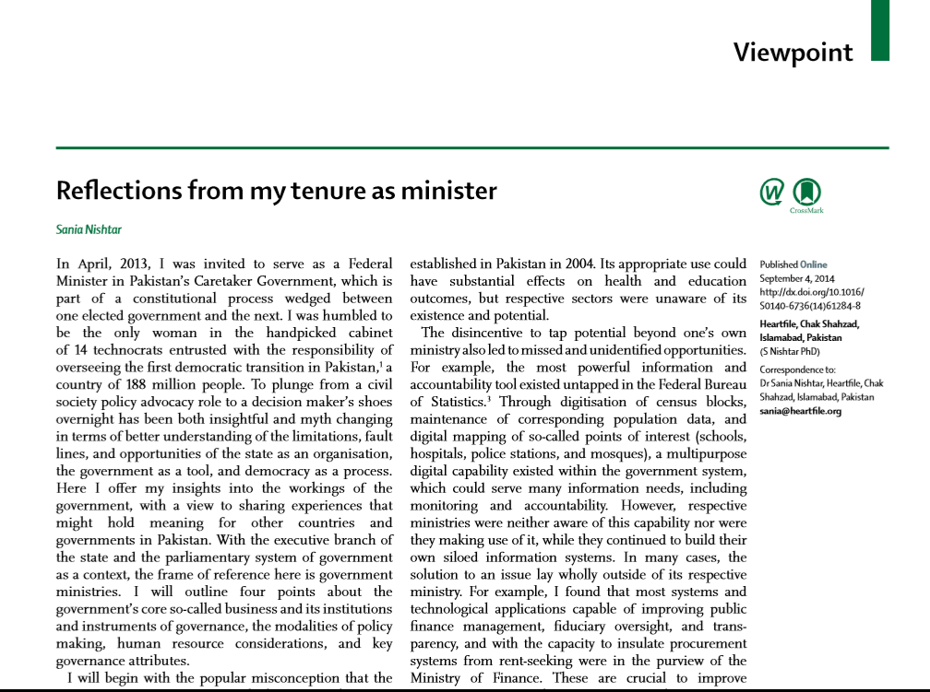
Mechanisms to forge partnership within government so as to integrate social, economical and environmental polices
2
Partnership building is needed first in the government systems
New tools
  Intermediary agencies skilled to convene
  Instruments for asset allocation mapping
  Incentives for collaborative division of labour
  Metric for whole of government and whole of system performance

Slide 6
Overall governance and macro-level change
3
Structures and systems to forge inter-sectoral collaboration between government, civil society and the Private sector
Enabling institutions to create, synthesize & apply interdisciplinary knowledge to strengthen health and the state of natural systems on which it depends
Training a cadre of future leaders
Overcoming governance constraints, including corruption
4
5
6

Slide 7
Health systems
7
Promoting health systems resilience
Espousing Universal Heath Coverage as a policy choice
Exploiting synergy with regard to sustainability and efforts to curb NCDs
A renewed emphasis on family planning
Promoting a collaborative mind-set
8
9
10
11
Notes:
Health systems are aware, can adapt, and are self regulating so that

Slide 8
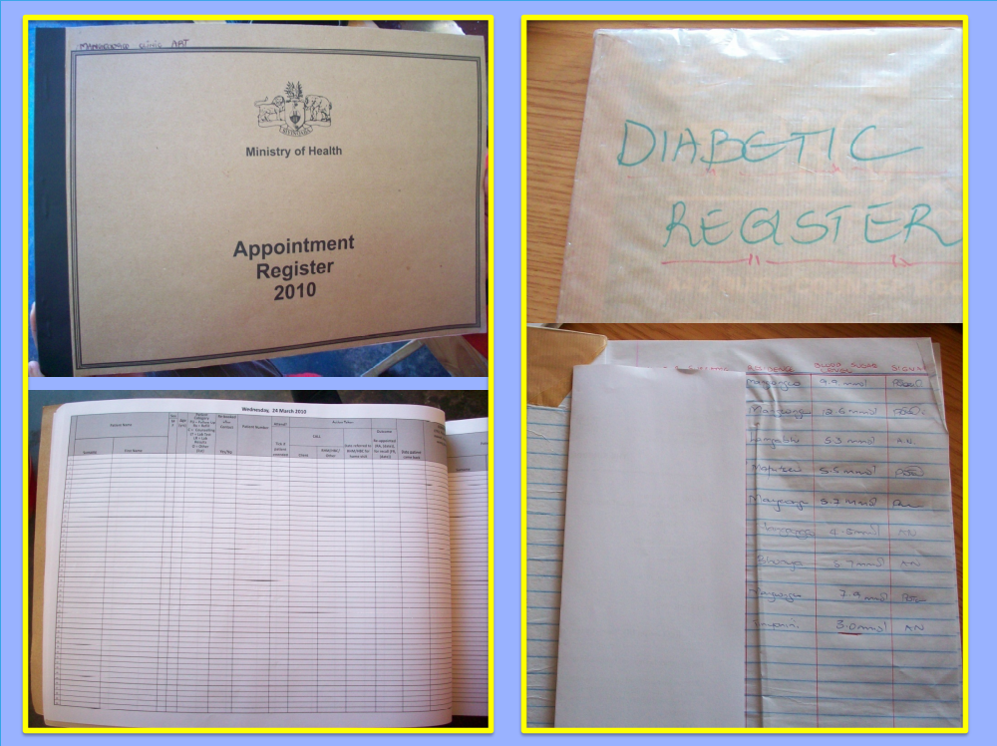
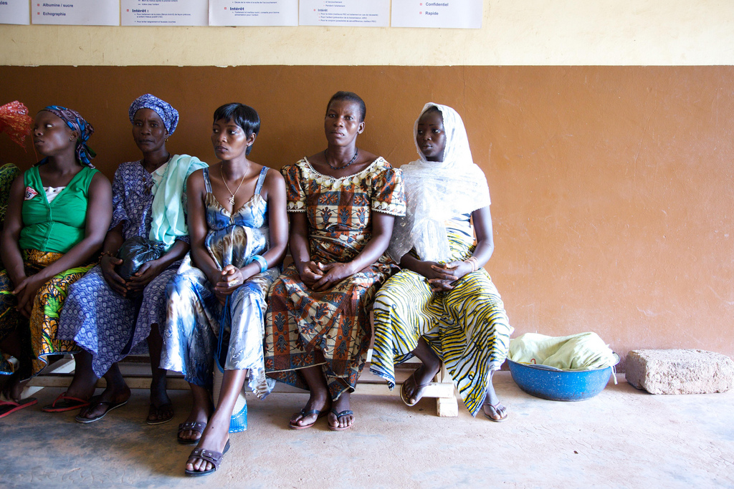
Notes:
.

