Slide 1
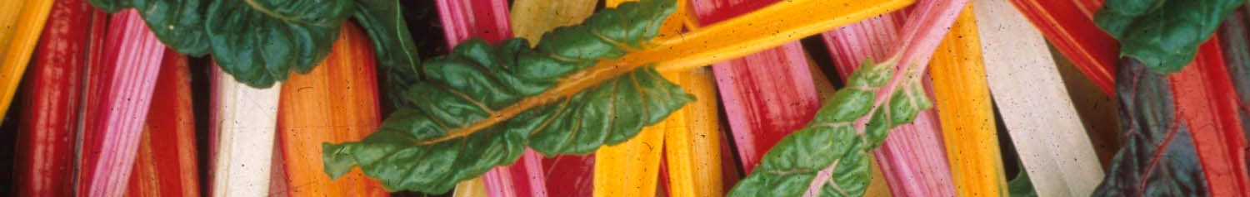
Climate and Health Summit: 2015
Walter C. Willett, MD, DrPH
Department of Nutrition
Harvard T. H. Chan School of Public Health
December 5, 2015

Slide 2

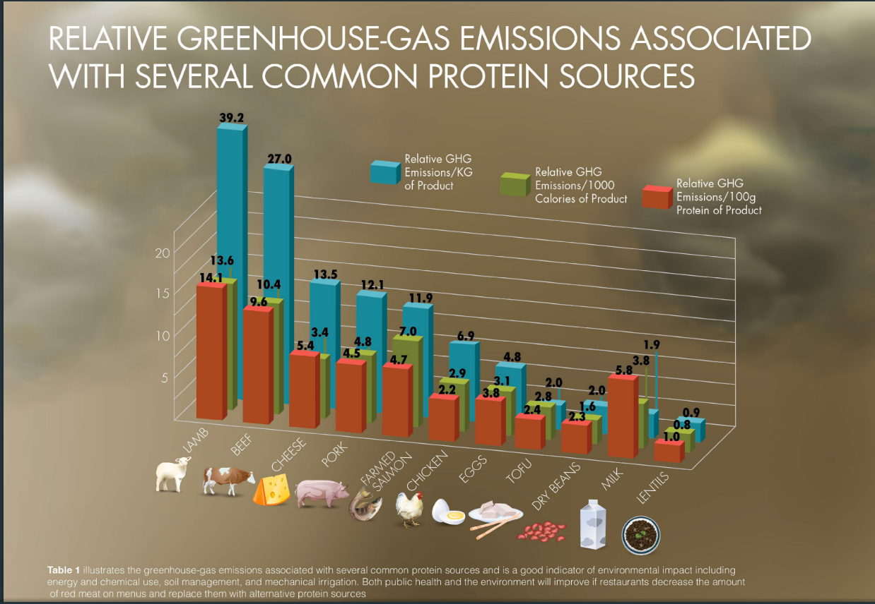
29.616

Slide 3
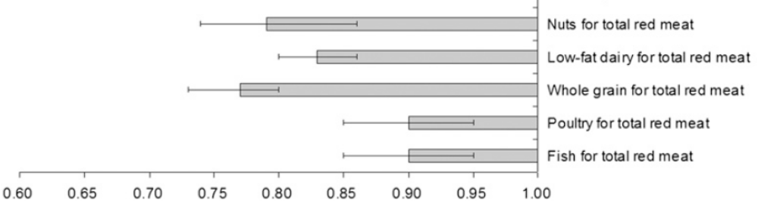
Relative Risk of type 2 diabetes for replacing 1 serving/day of total red meat with other foods. Data from NHS, NHSII, HPFS, including 13,759 cases of diabetes (Pan A et al. AJCN, 2011)
Relative Risk
25.161

Slide 4
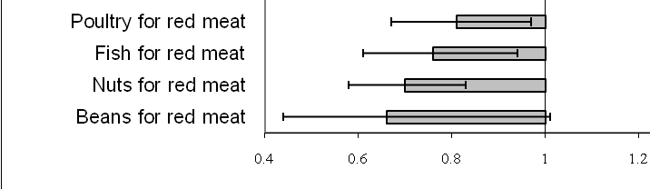
Substitution of Protein Sources (1 sv/day) and Risk of CHD in NHS, 1980-2006 (3162 cases)
9.202a
Bernstein A, et al. Circulation. 2010;122(9):876-83

Slide 5
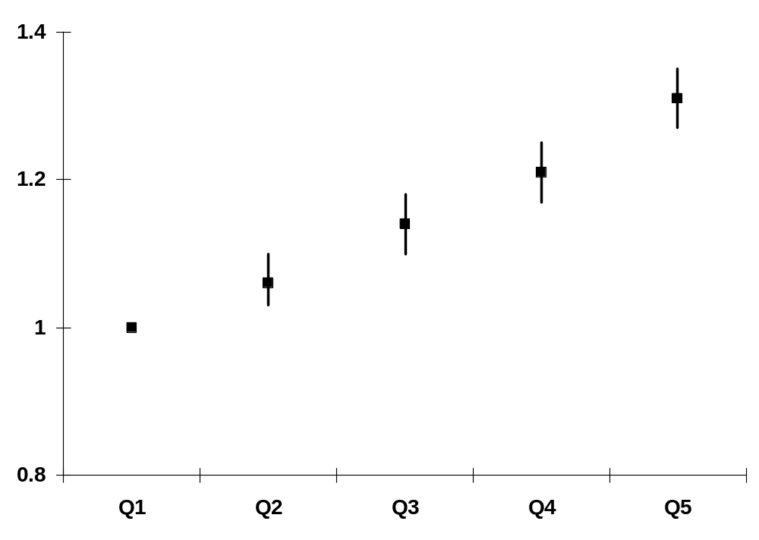
Multivariate RR for Red Meat Intake and Total Mortality in Men in NIH-AARP Study
Relative Risk
(P, trend=<.001)
Quintiles
29.327
(Sinha et al. 2009)

Slide 6
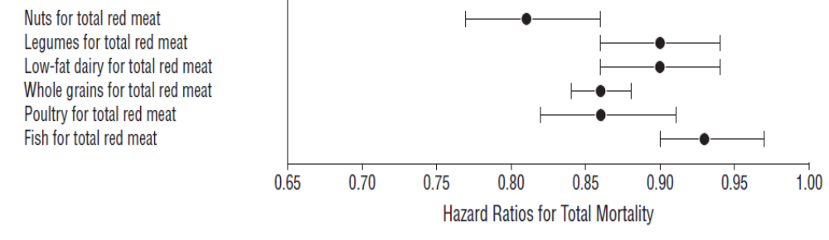
RR for total mortality for men and women associated with replacement of other food groups for red meat intake
Nuts for total red meat
Legumes for total red meat
Low-fat dairy for total red meat
Whole grains for total red meat
Poultry for total red meat
Fish for total red meat
(Pan A et al, Arch Intern Med 2012)
9.220

Slide 7
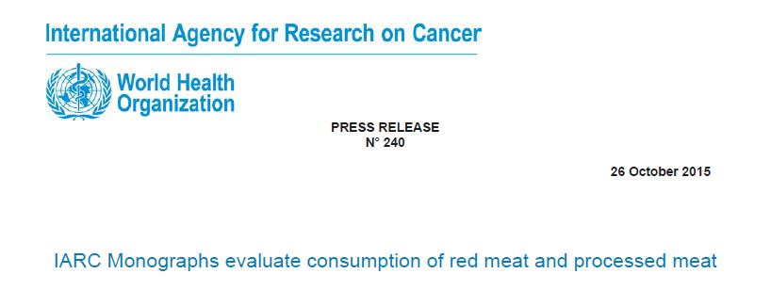
Red meat was classified as probably carcinogenic to humans (Group 2A)
Processed meat was classified as carcinogenic to humans (Group 1)
29.628

Slide 8
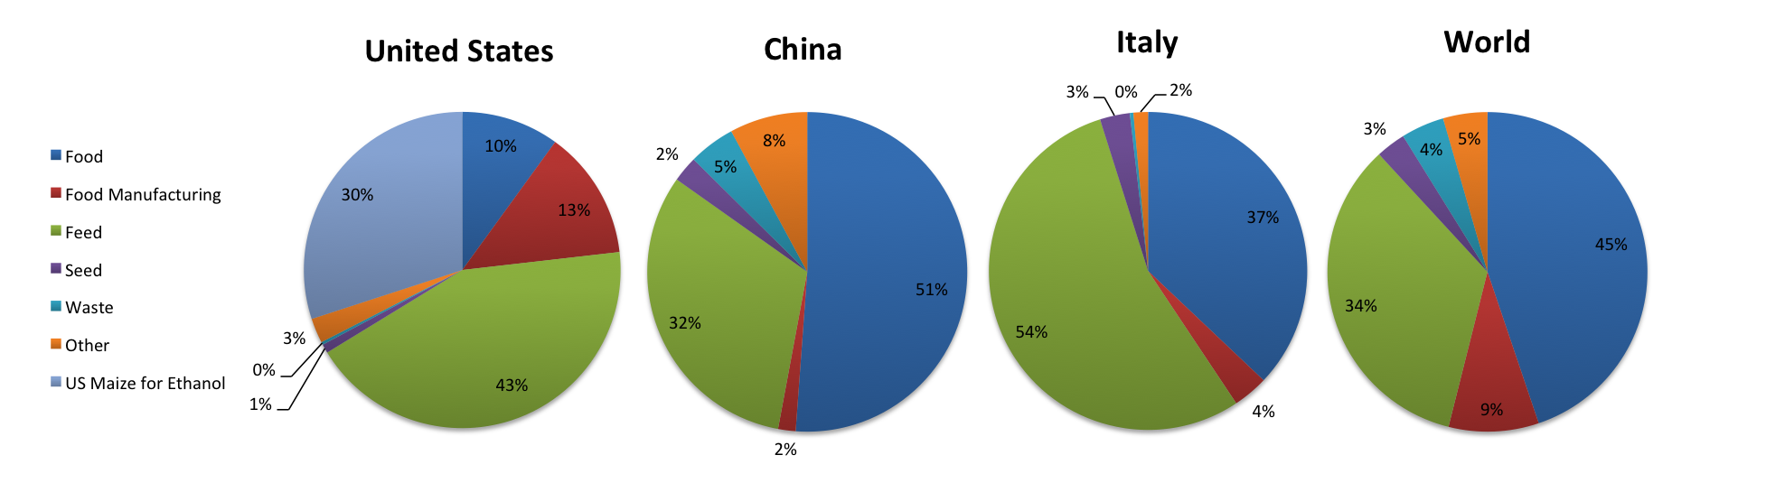
Domestic Uses of Grain in the US
29.621
http://faostat3.fao.org/home/E.

Slide 9
Domestic Uses of Grain in China
29.623
http://faostat3.fao.org/home/E.

Slide 10

Conclusions
Limiting red meat intake will have benefits for human and planetary health
In general, emphasizing vegetable sources of protein over animal sources will have similar benefits, but modest consumption of poultry and fish are compatible with human and environmental health
Further attention to every step of food production, transportation, processing, and storage can further reduce fossil fuel consumption and GHG production
29.629

